Slide 1
USDA ERS Broadband: project overview
Evaluating Subsidy Programs
Aritra Halder, Joshua R. Goldstein, Hannah Charankevich
USDA ERS Sponsor: John Pender
Social and Decision Analytics Division (UVA-SDAD),
Economic Research Service-U.S. Dept. of Agriculture.
Data Science for Public Good 2022

Slide 2
Motivation
Broadband investment is a high priority for the Administration and Congress
Importance of broadband even more evident in current pandemic
Little research has investigated the economic impacts of broadband programs
The Broadband Initiatives Program (BIP), enacted as part of the American Recovery and Reinvestment Act in 2009, is the largest rural broadband program to date – with an appropriation of $2.5 billion.
The purpose of this study is to devise novel statistical methodology that allow for program evaluation for BIP.
Notes:
* $1.8 billion in funding in FY 2018 – 2020 for rural broadband through new ReConnect Program. Several other USDA and FCC programs also promote broadband
* Kandilov and coauthors investigated impacts of the Farm Bill Broadband Loan (FBBL) program on various economic outcomes prior to 2010 in several papers (Kandilov and Renkow 2010; Kandilov et al. 2017; Kandilov and Renkow 2020). Kandilov & Renkow (2020) also examined impacts of the Community Connect Grant program prior to 2010.
* Dinterman and Renkow (2017) investigated impacts of the FBBL program on number of broadband providers, also prior to 2010

Slide 3
Data Sources and Methods
Identified data sources that reflect effect of broadband
CoreLogic: Property Values and Housing Characteristics
Assessed Property Values
Ookla Data
American Community Survey (ACS): Demographic variables
RUS Program boundary and associated shapefiles
Modeling the house prices using an approximate hierarchical Bayesian spatial model (Datta et. al. 2016, Rue et. al. 2009)
Featuring an off-the-shelf inference for difference-in-difference estimators
Posterior surface analysis is performed for studying impacts using
Regression Discontinuity Analysis
Gradient Assessment
Notes:
Datta, Abhirup, et al. "Hierarchical nearest-neighbor Gaussian process models for large geostatistical datasets." Journal of the American Statistical Association 111.514 (2016): 800-812.
Rue, Håvard, Sara Martino, and Nicolas Chopin. "Approximate Bayesian inference for latent Gaussian models by using integrated nested Laplace approximations." Journal of the royal statistical society: Series b (statistical methodology) 71.2 (2009): 319-392.
Womble, William H. "Differential systematics." Science 114.2961 (1951): 315-322.

Slide 4
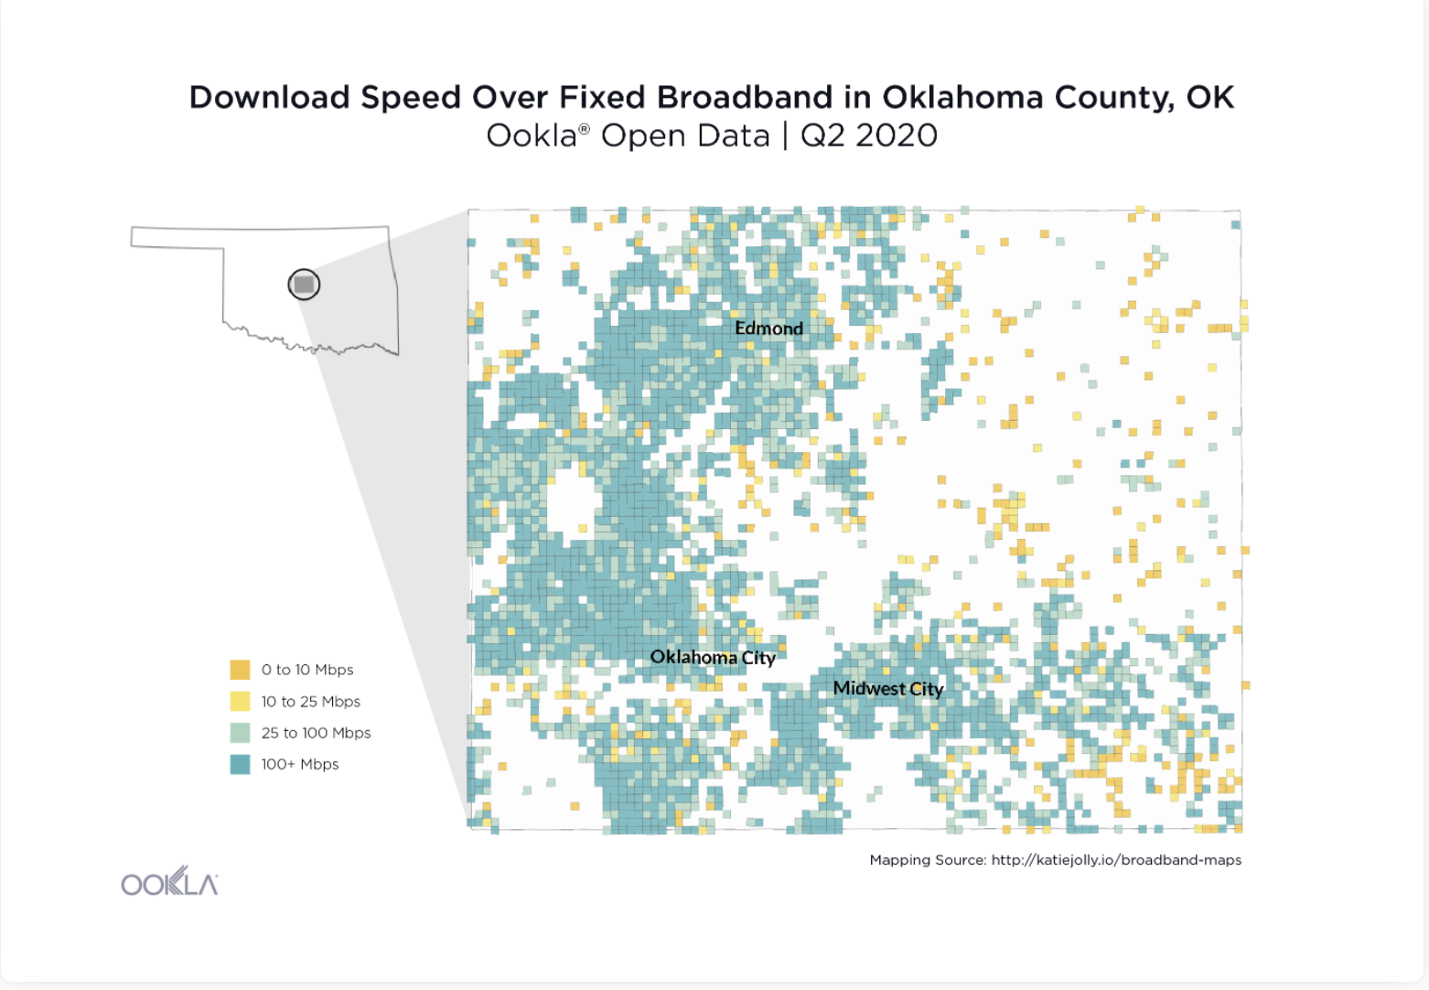
Ookla Data and the ReConnect
Linking the ReConnect program with Ookla Download speed data
600 sq. ms sized grid over which data is recorded

Slide 5
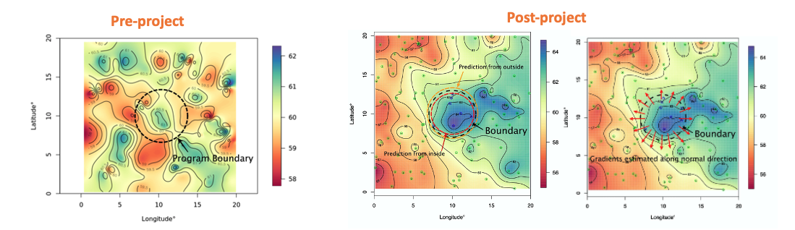
Rationale
We compare the estimated spatial surface for house prices across the program boundary before and after program implementation.
A steep gradient or sharp discontinuity in the surface is evidence of rapid change at the RUS boundary.

Slide 6
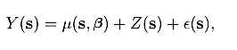
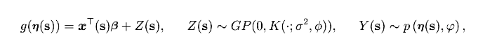
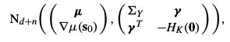
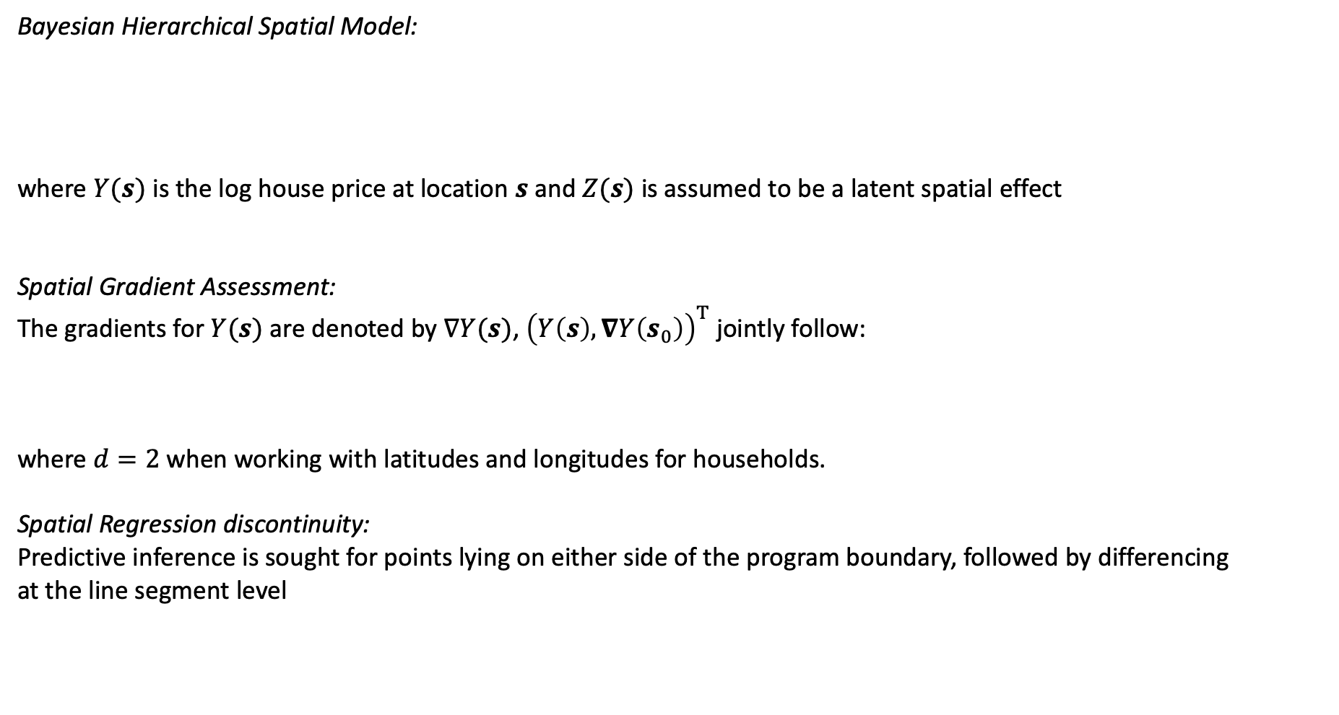
Theoretical Setup
Bayesian Hierarchical Spatial Model:
where $Y(s)$ is the log house price at location $s$ and $Z(s)$ is assumed to be a latent spatial effect
Spatial Gradient Assessment:
The gradients for $Y(s)$ are denoted by $∇Y(s)$, ${\left(Y\left(s\right),∇Y\left(s_{0}\right)\right)}^{T}$ jointly follow:
where $d=2$ when working with latitudes and longitudes for households.
Spatial Regression discontinuity:
Predictive inference is sought for points lying on either side of the program boundary, followed by differencing
at the line segment level
Notes:
following an approximate
spatial process whose variability is governed by the covariance matrix $K$ which is a function of inter-site Euclidean
Distance $Δ=|\left|s−s^{′}\right||$ between locations $s$ and $s′$.

Slide 7
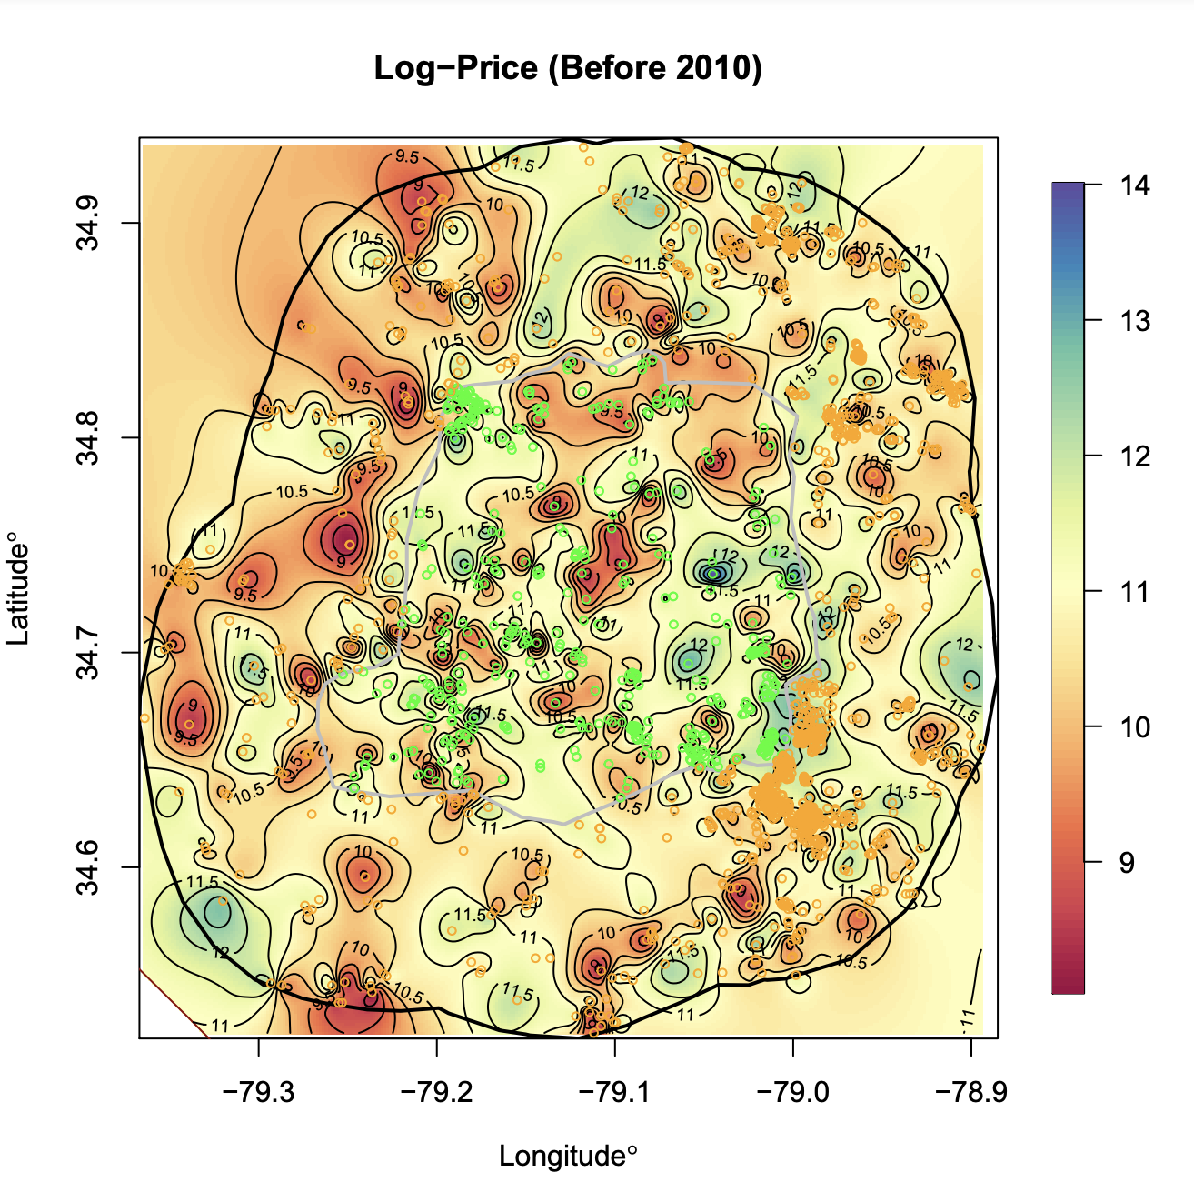
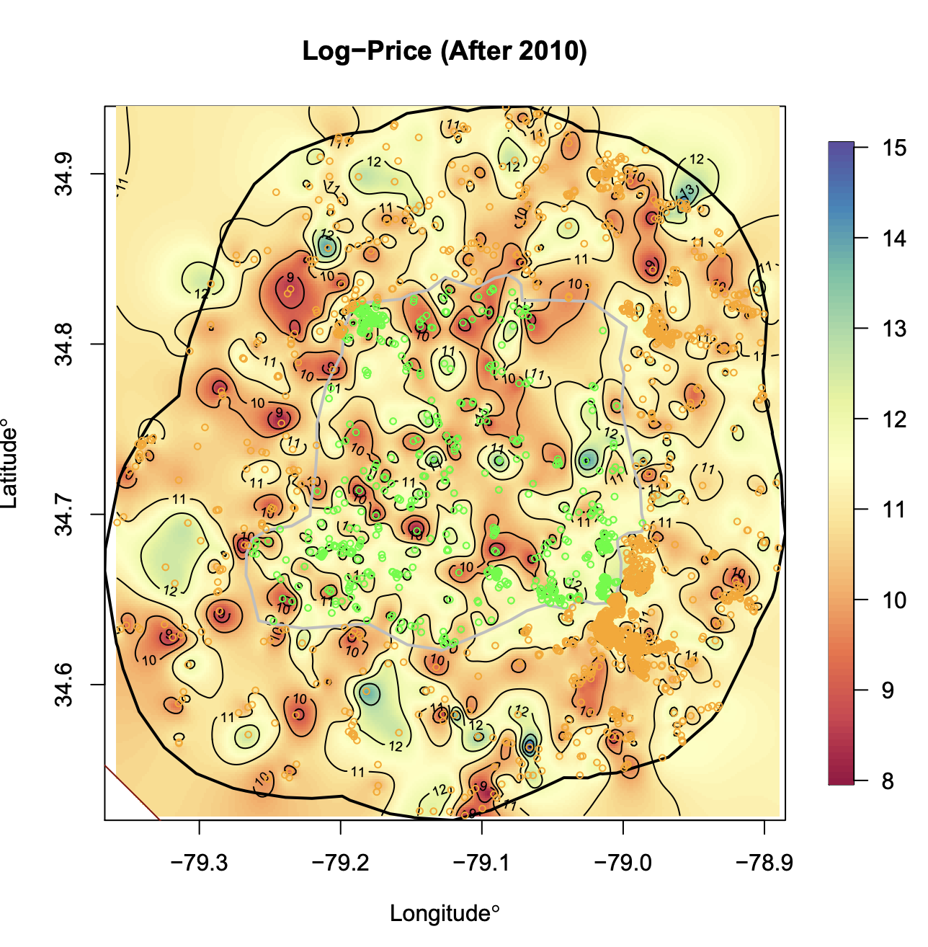
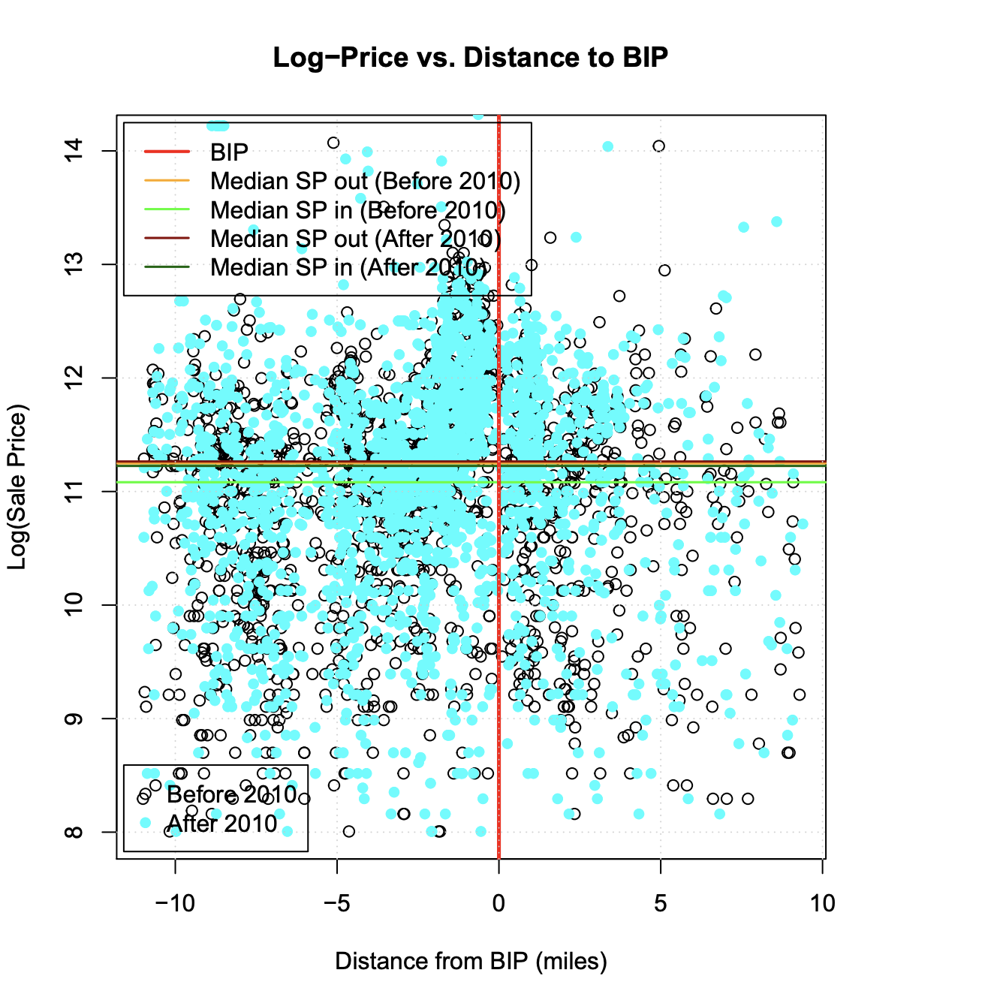
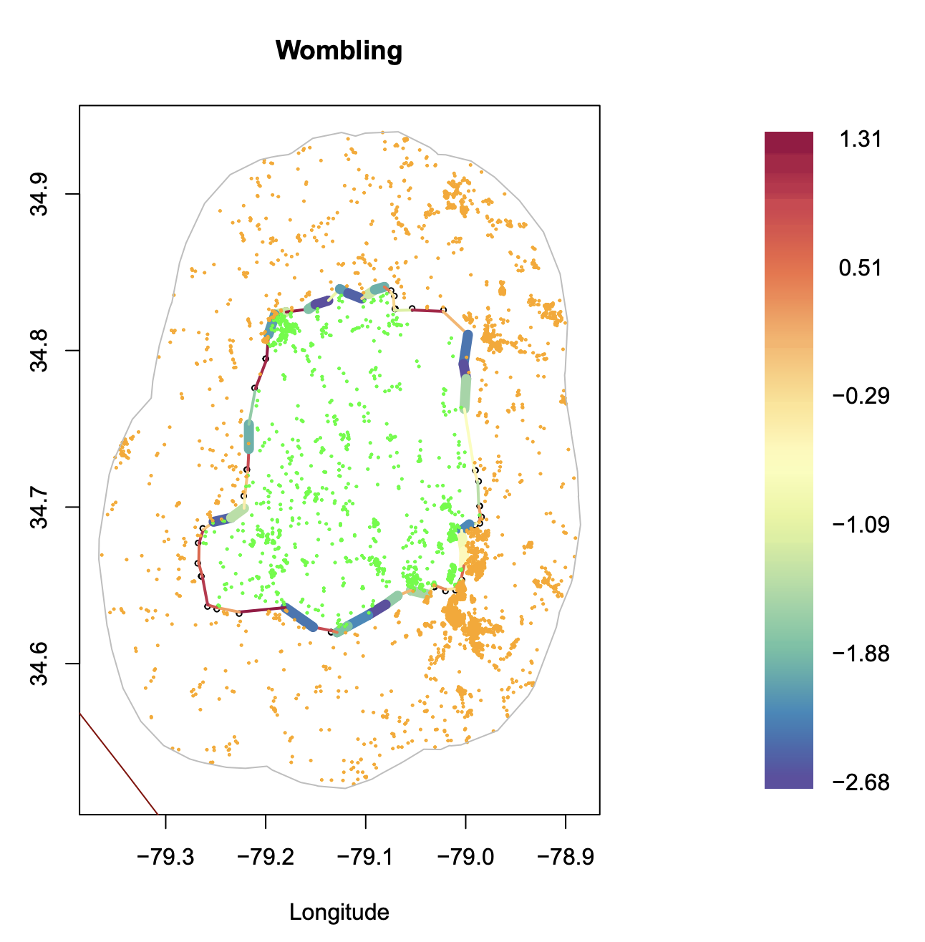
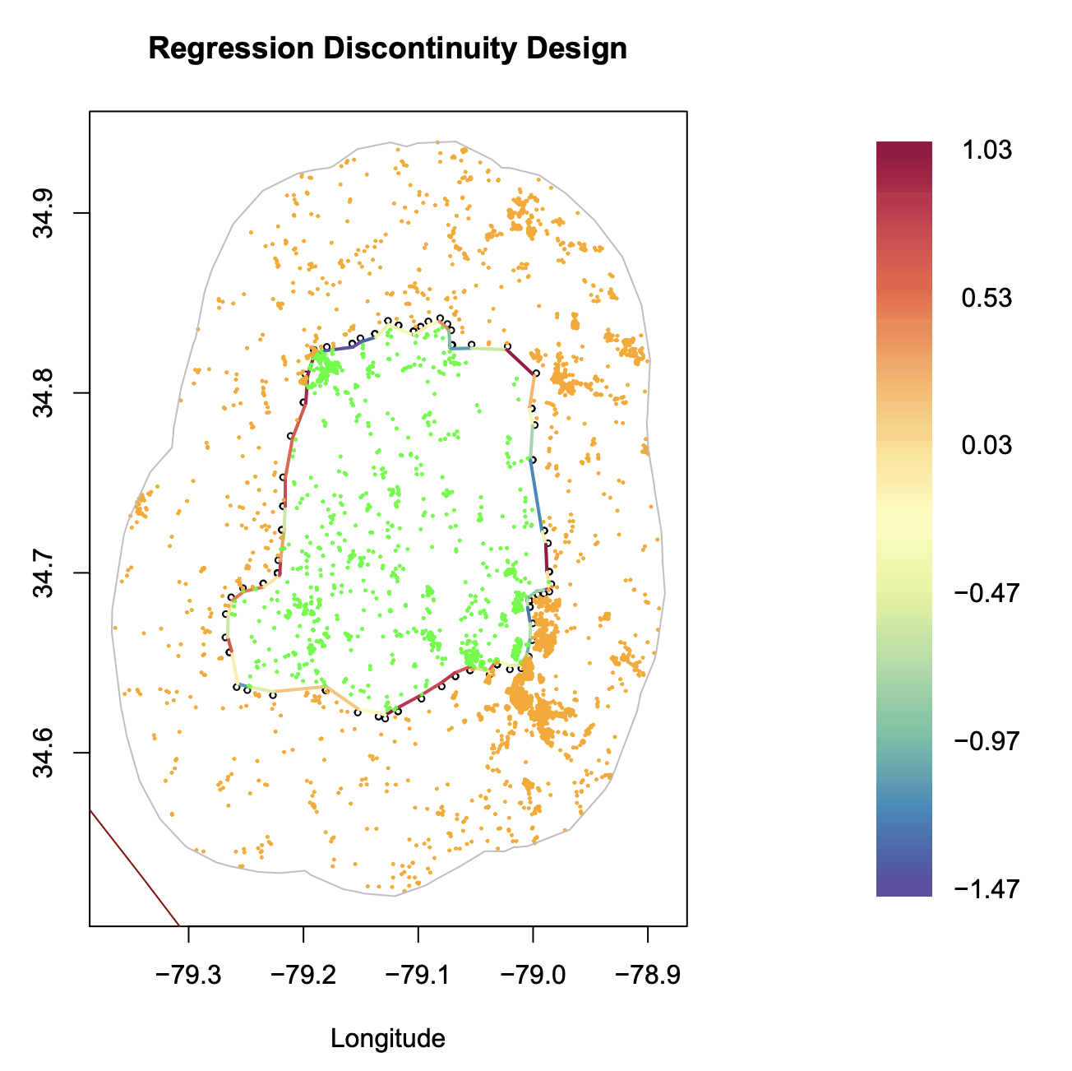
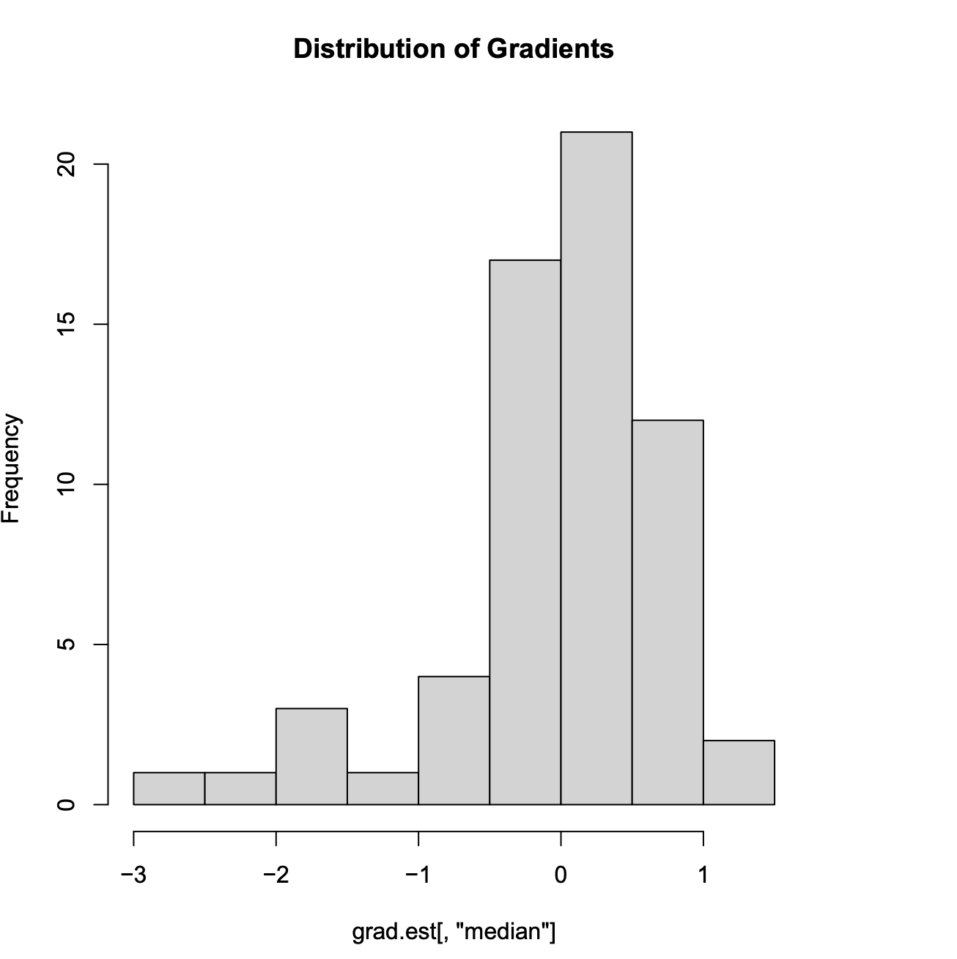
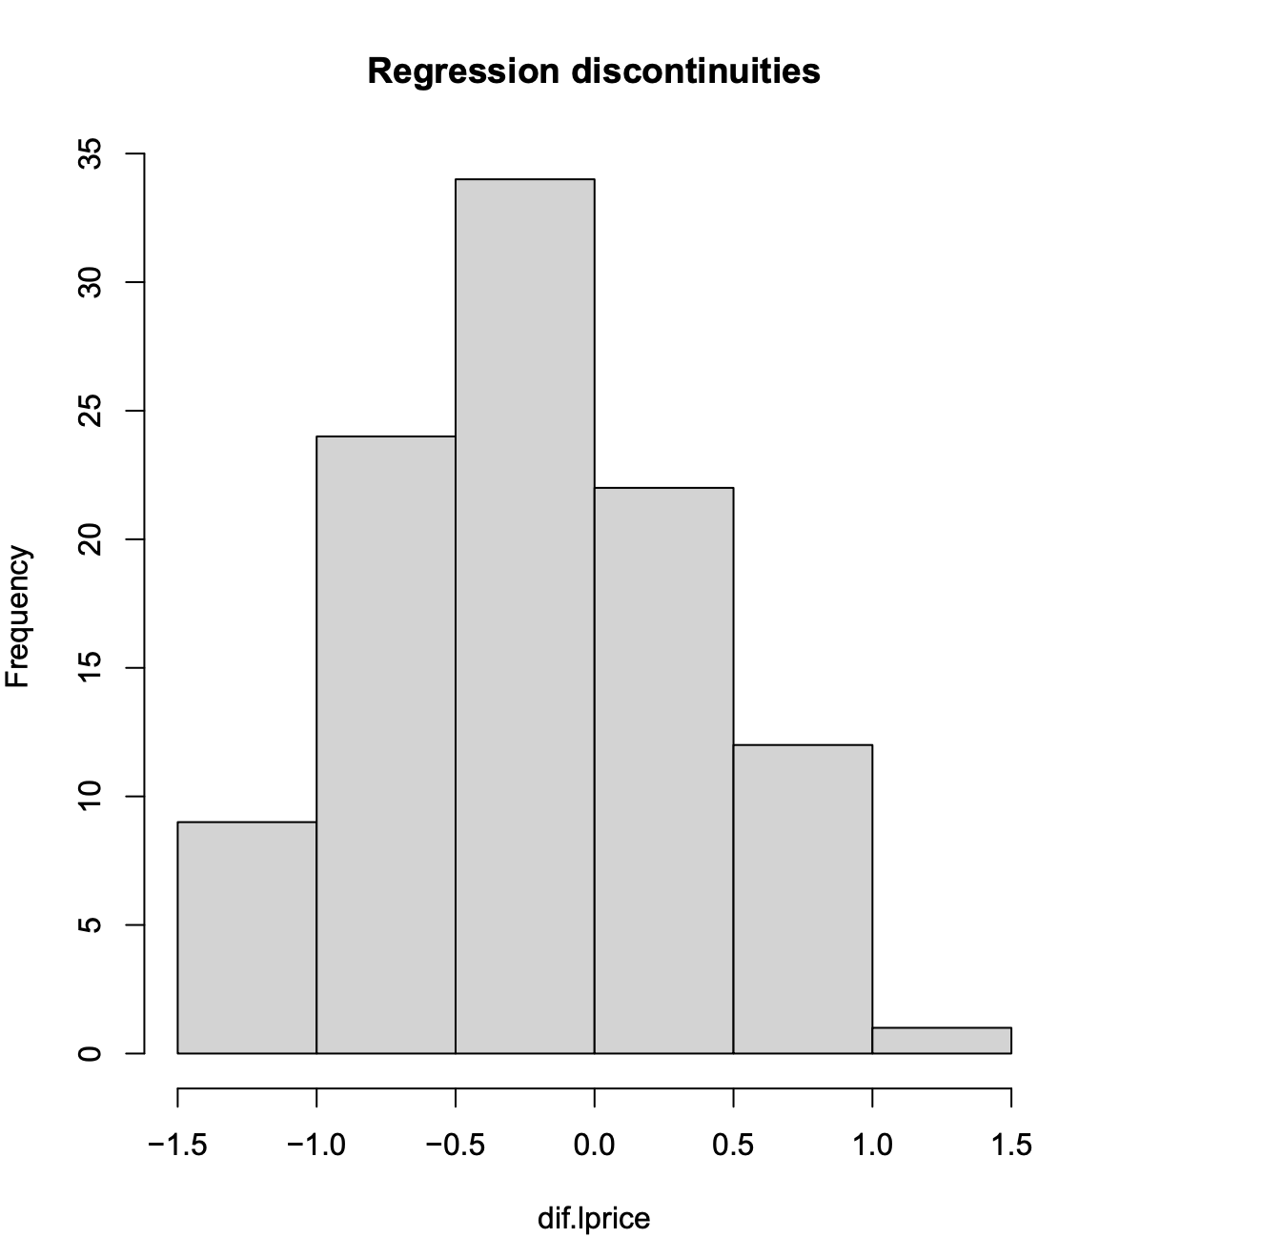
Case Studies: North Carolina
Difference (pre) = -0.1709
Difference (post) = -0.0459
37% significant gradients, no discontinuities, avg. wombling measure = -0.9061. Prices increased by an average of 40% inside the BIP.

Slide 8
BIP Analysis : National Level
There were a total of 297 RUS Awards granted out of which 100 had valid arms-length house sales values in the CoreLogic database.
Approach 1: Combine data and perform a hedonic regression analysis using OLS
The Difference in Difference (DID) estimate was recorded for each model, along with its standard deviation.
Approach 2: The hierarchical Bayesian spatial regression model was fitted for each of the RUS IDs with a 10-mile radius.
This was followed by a regression discontinuity analysis and spatial gradient assessment.
Notes:
The RD and gradient assessment plots for some of the BIPs will be included in the final report.

Slide 9
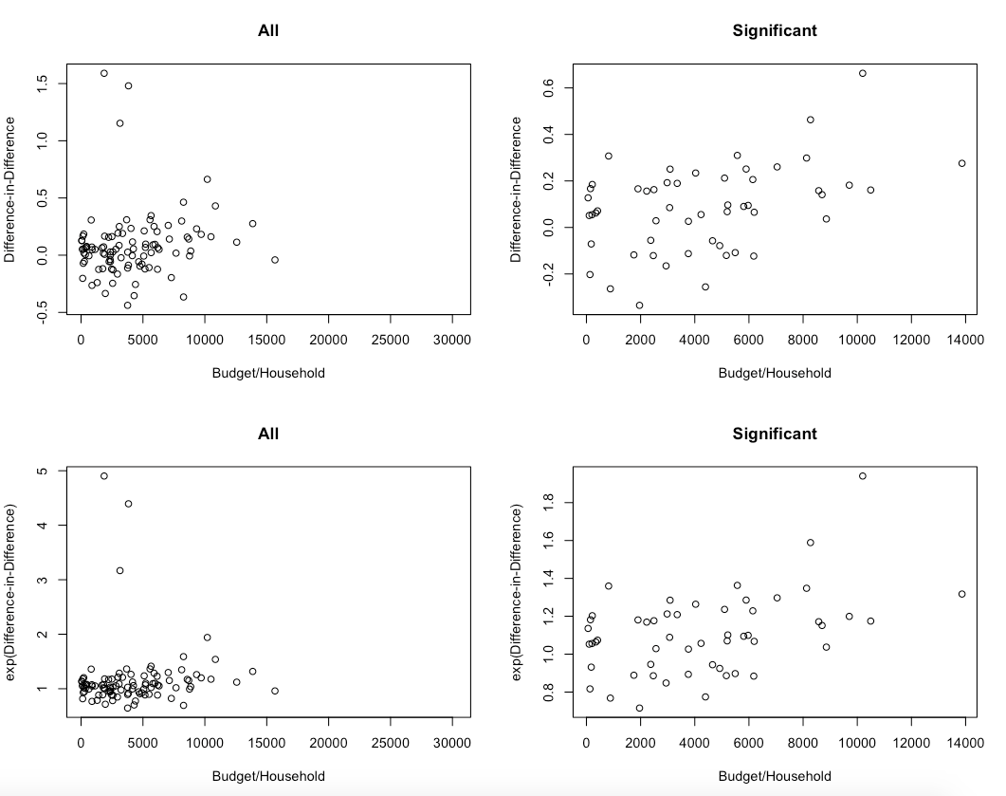
DID Estimates vs Loan amount (Award/HH)

Slide 10
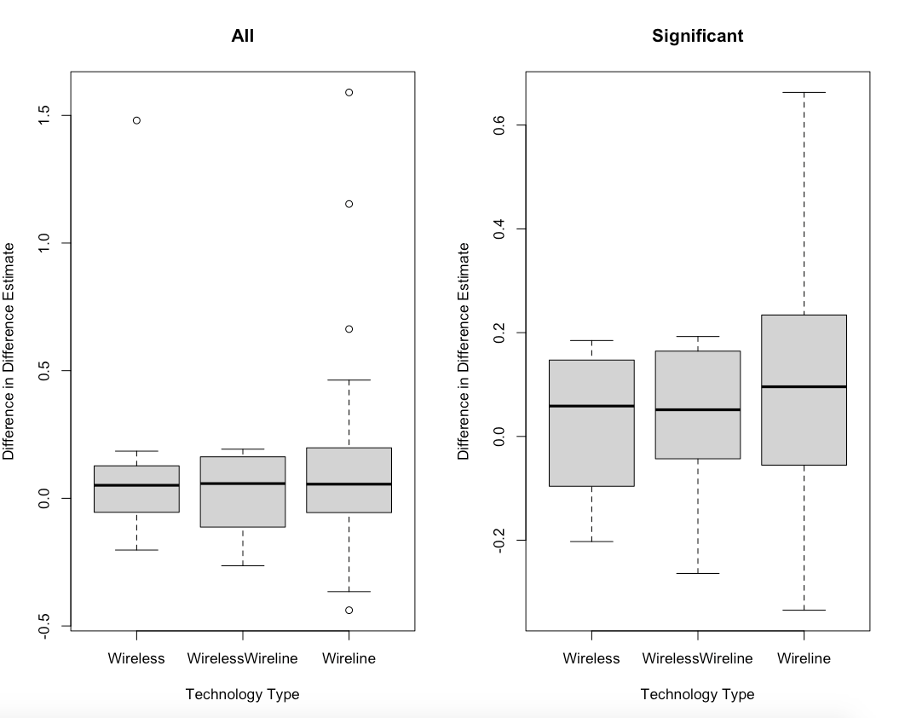
DID Estimates vs Technology Type

Slide 11
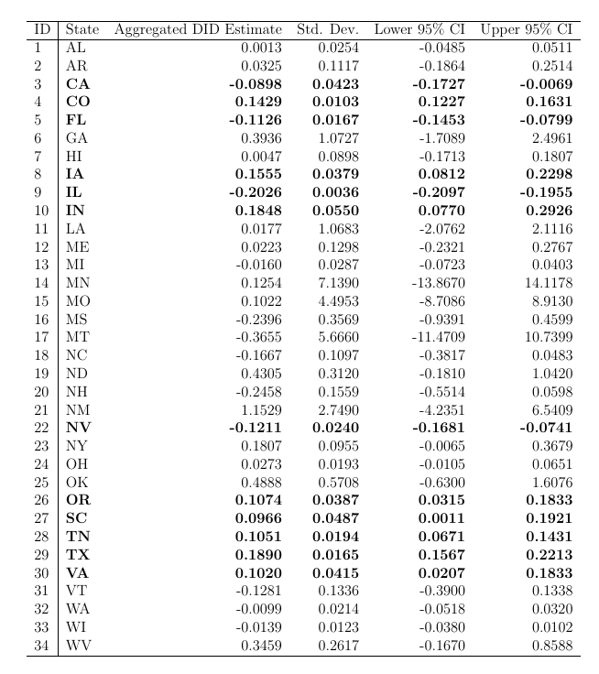
Aggregated DID Estimates: State Level
The DID estimates can be aggregated at the state level to produce estimates of efficacy at the state level.
Data was available for 34 states
for the CoreLogic arms-length sales.
Significant (at 95%) estimates are marked in bold.

Slide 12
Posterior Surface Analysis
Following the model fit (DID estimates shown previously), we proceed with posterior surface analysis using Regression Discontinuity Design and Gradient Assessment.
We record the following summaries (at the line segment level):
%ge of discontinuities/gradients significant
Difference in log-house prices (inside vs outside the BIP) (before 2010) and (post (2010): this allows us to check the continuity assumption for DID
Average discontinuity along the BIP boundary
Average Gradient for the BIP boundary for every program area

Slide 13
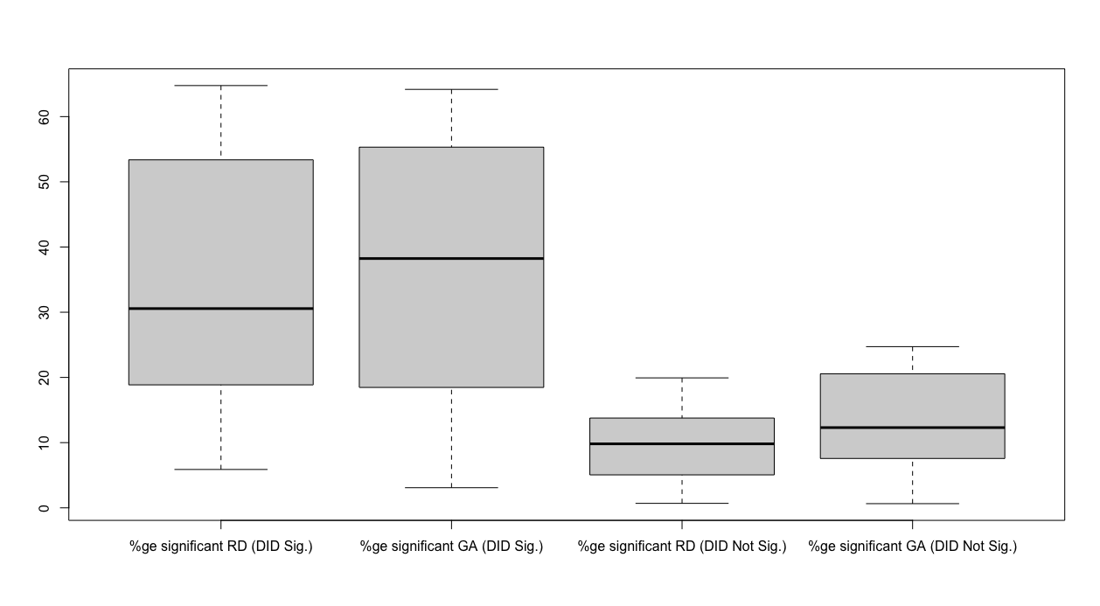
Comparison of Significance
Figure showing the %ge significance based on if significant DID

Slide 14
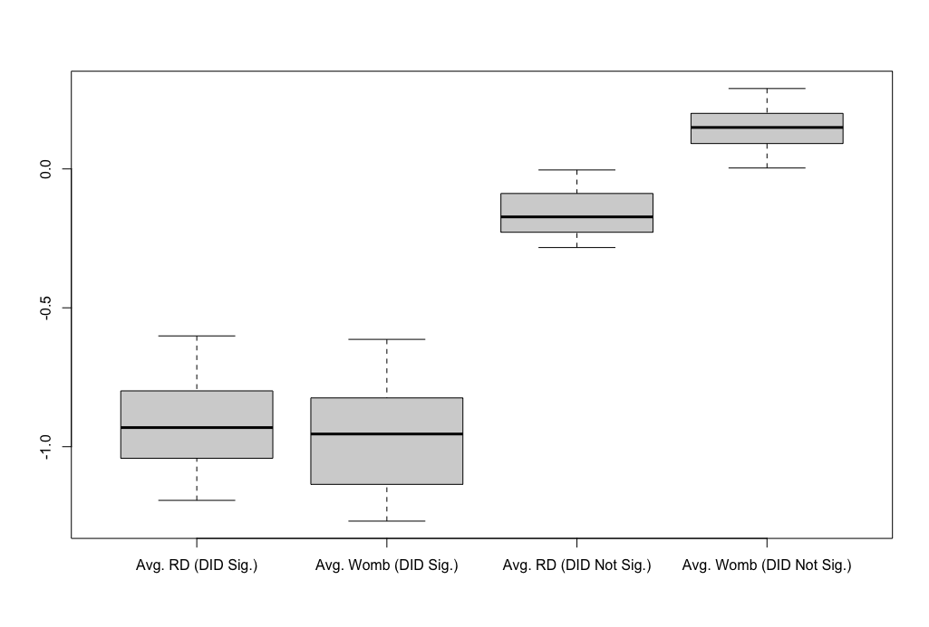
Comparison of Significance
Figure showing the average wombling measure and discontinuities based on if significant DID.

Slide 15
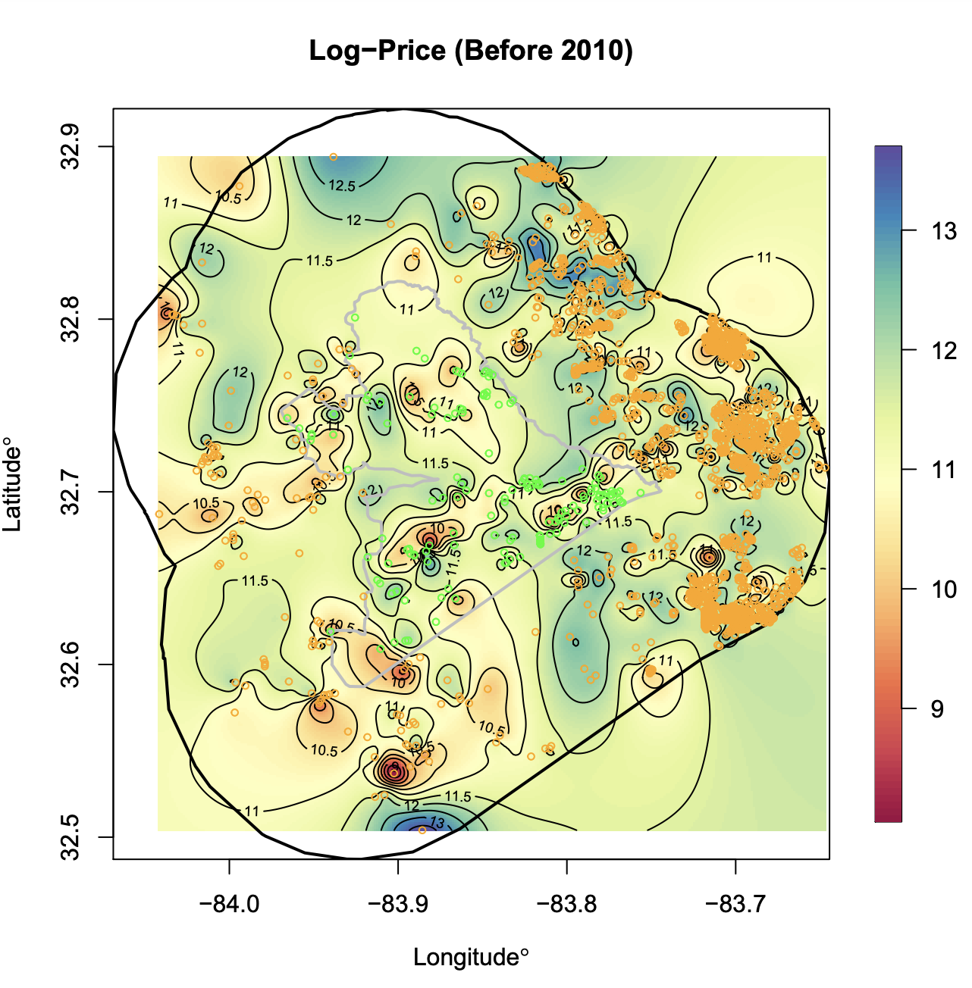
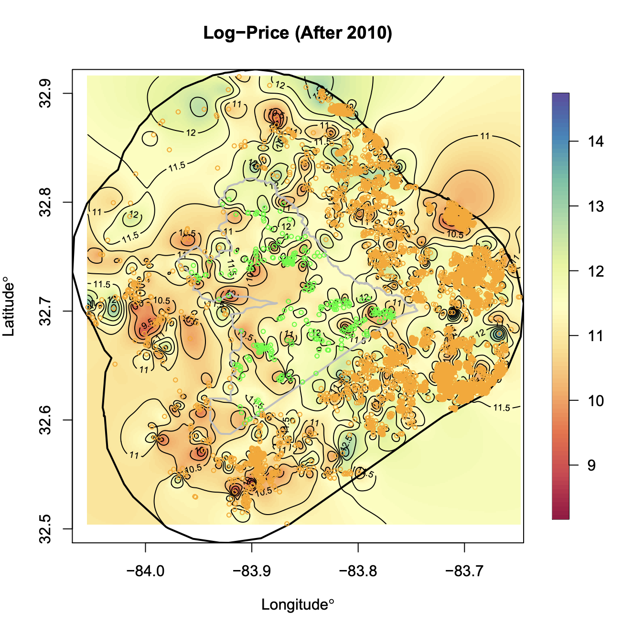
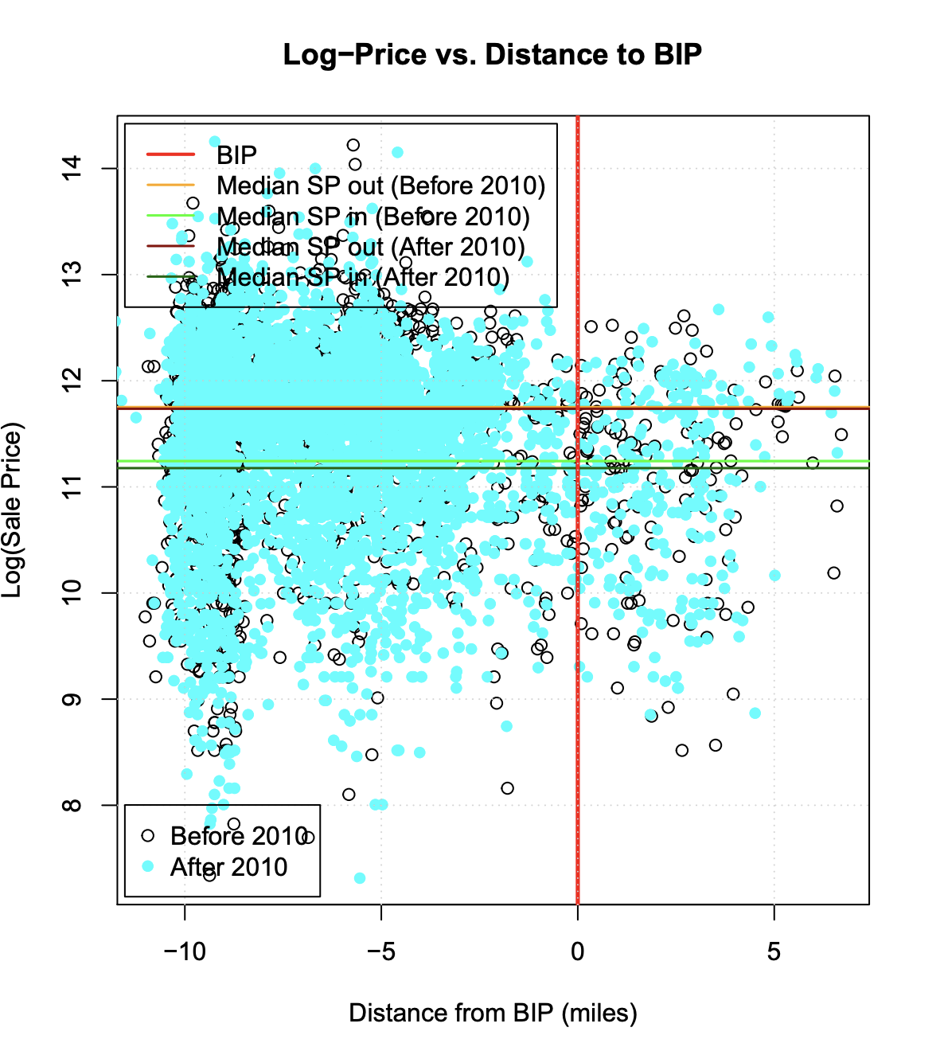
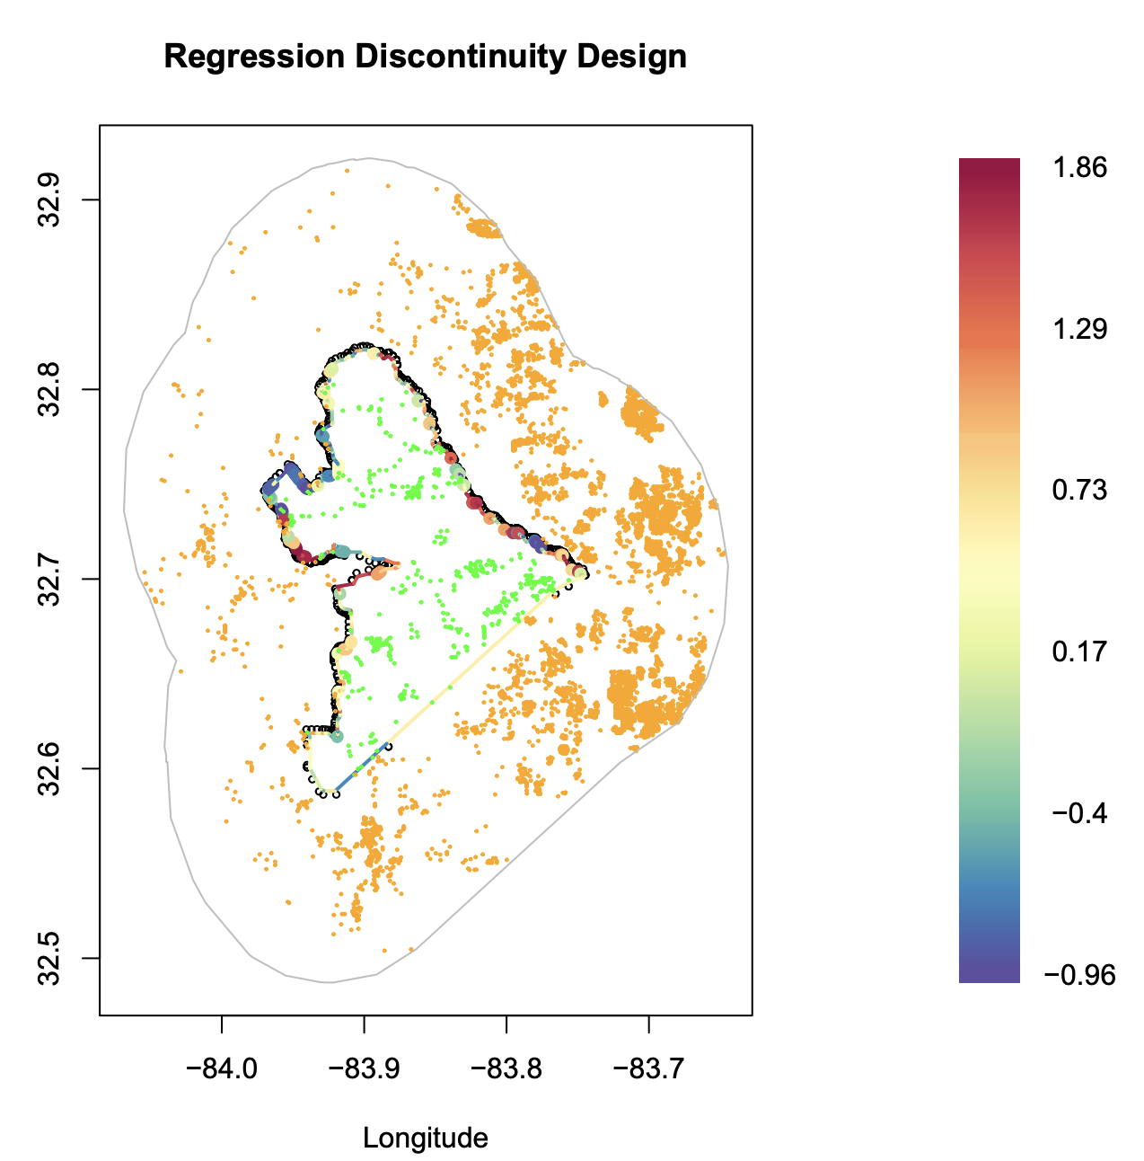
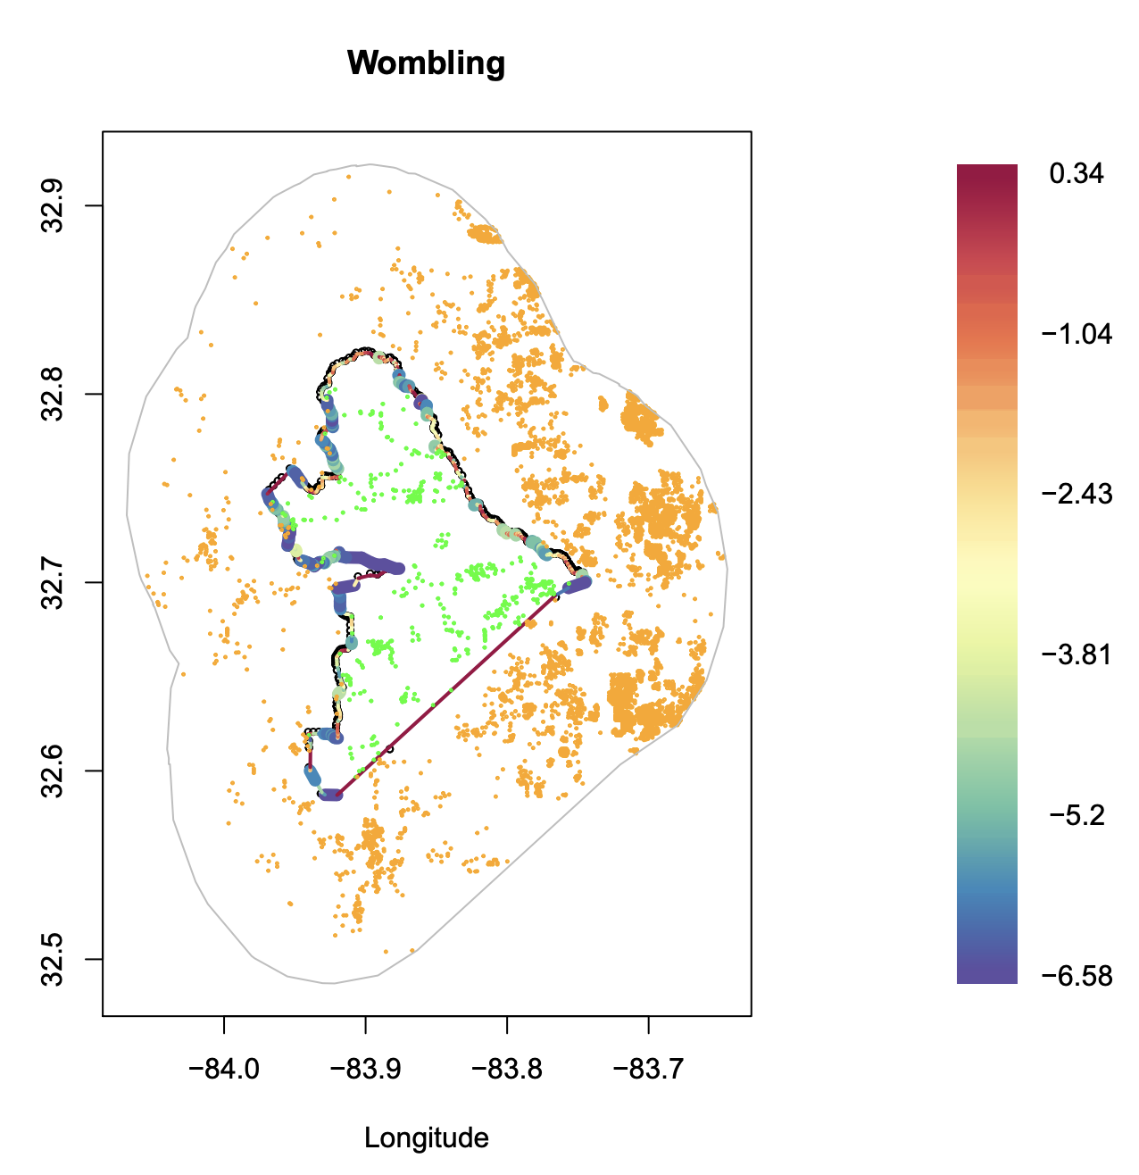
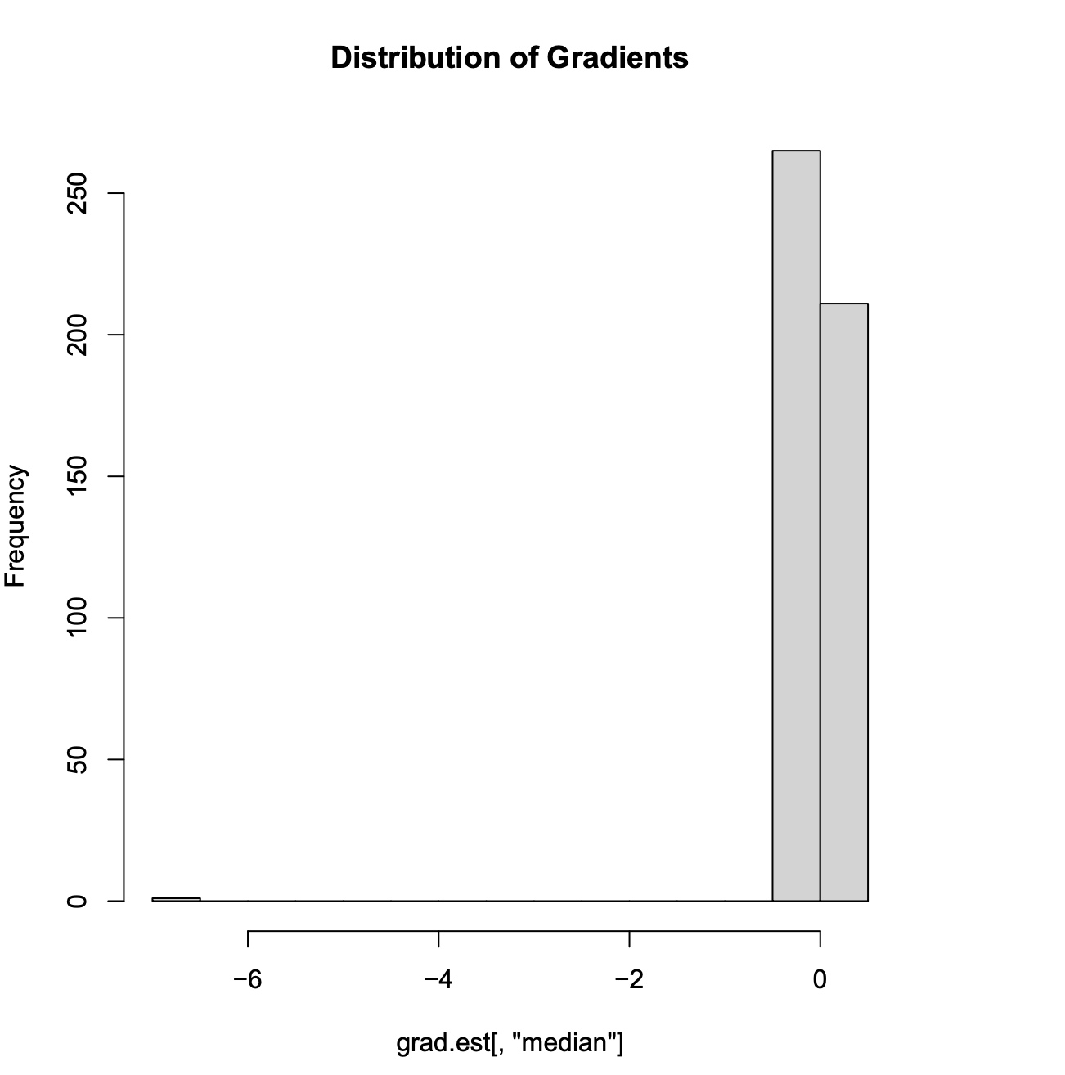
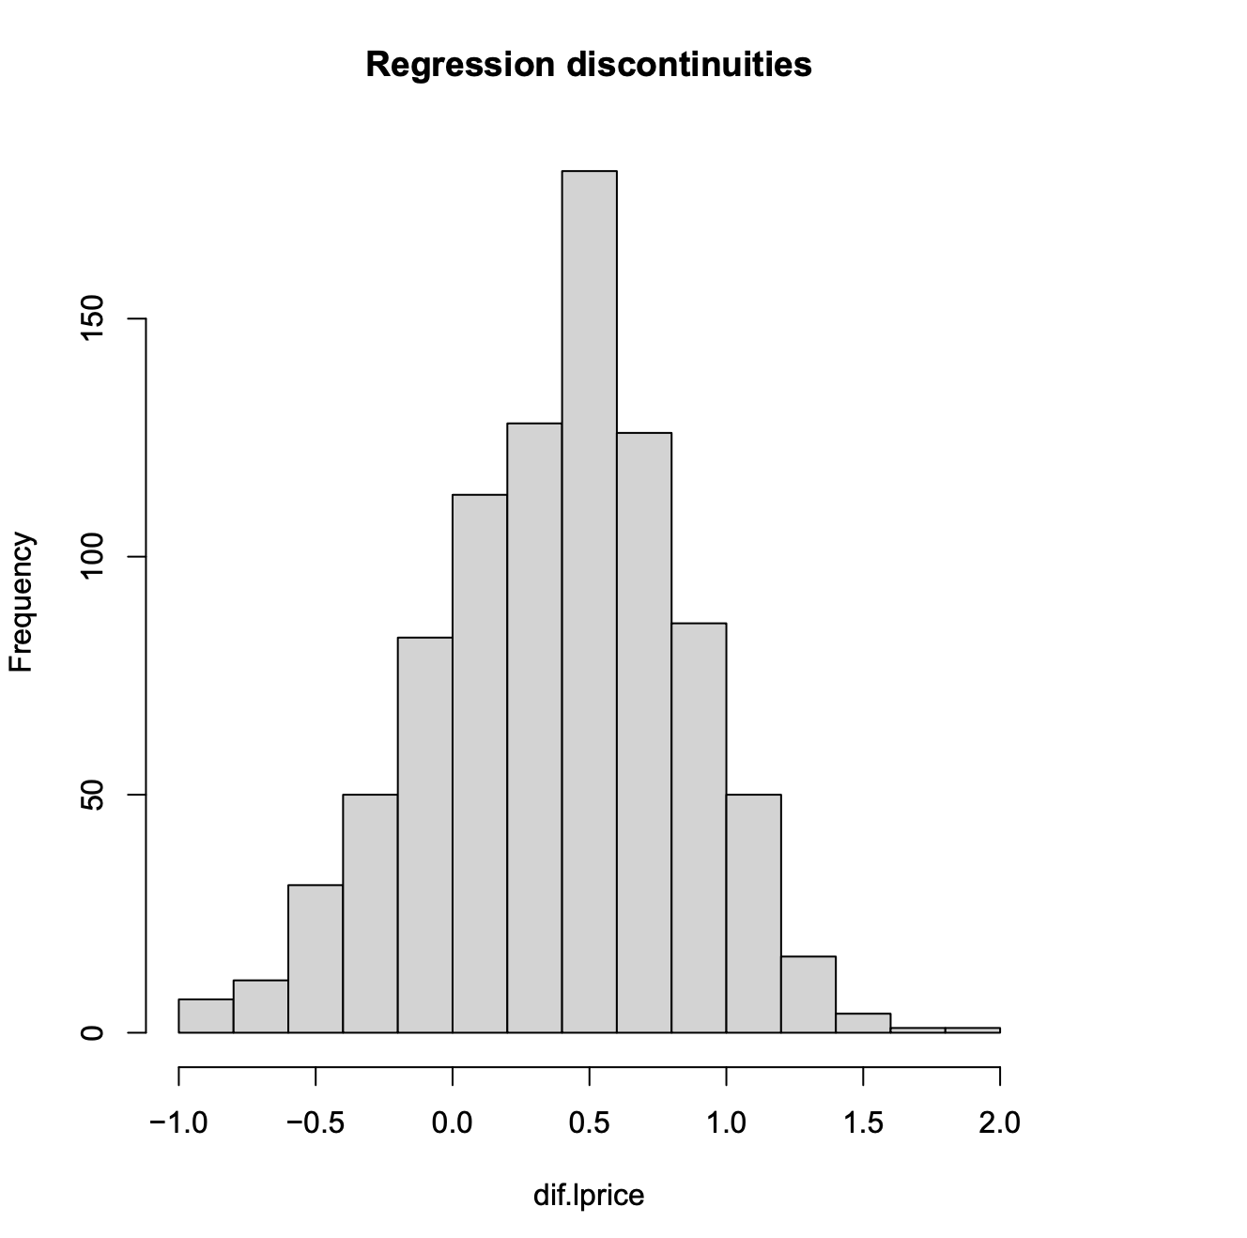
Case Studies: Georgia
Difference (pre) = -0.4781
Difference (post) = 0.4456
25% significant gradients, 7% discontinuities, avg. wombling measure = -7.1089. Prices increased by an average of 0.08% (according to gradients)and 46% (according to the discontinuities) inside the BIP.

Slide 16
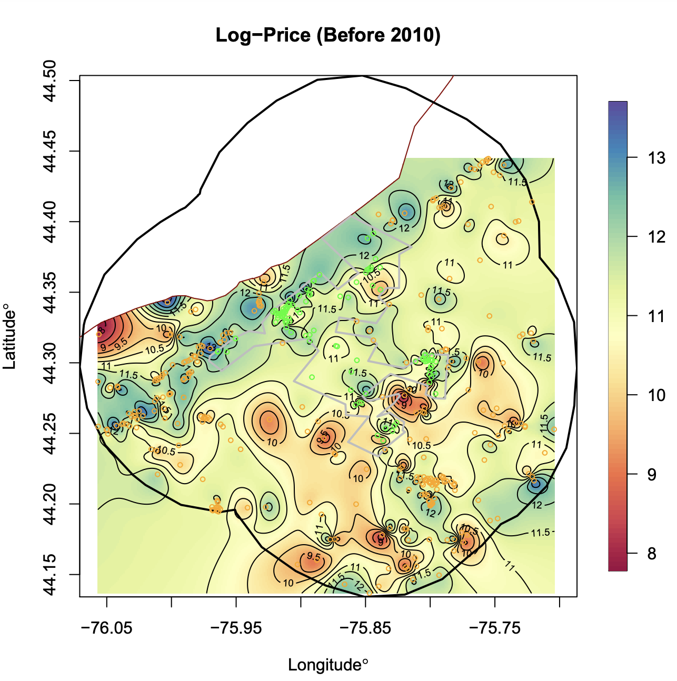
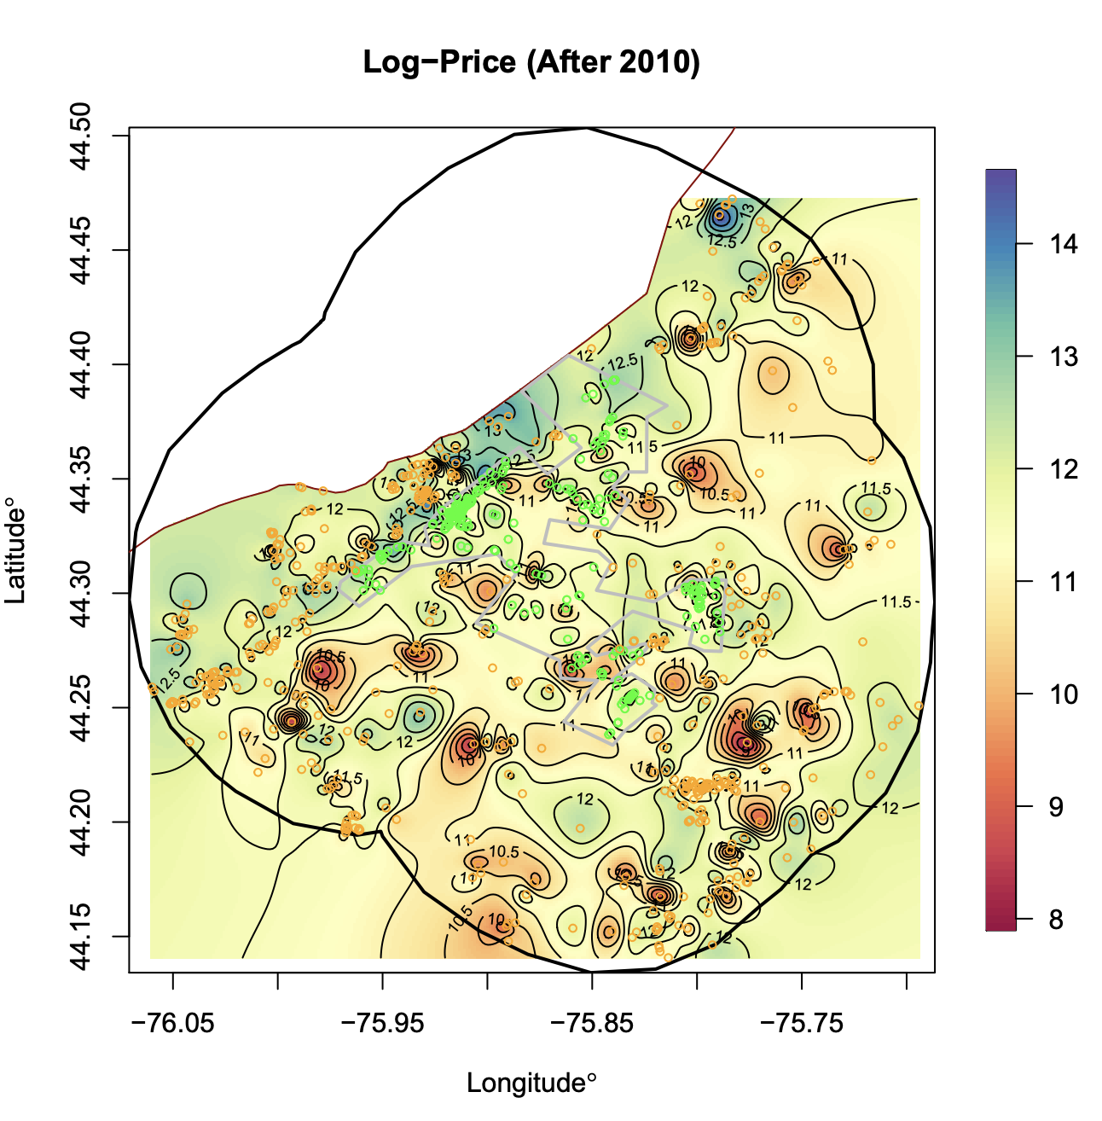
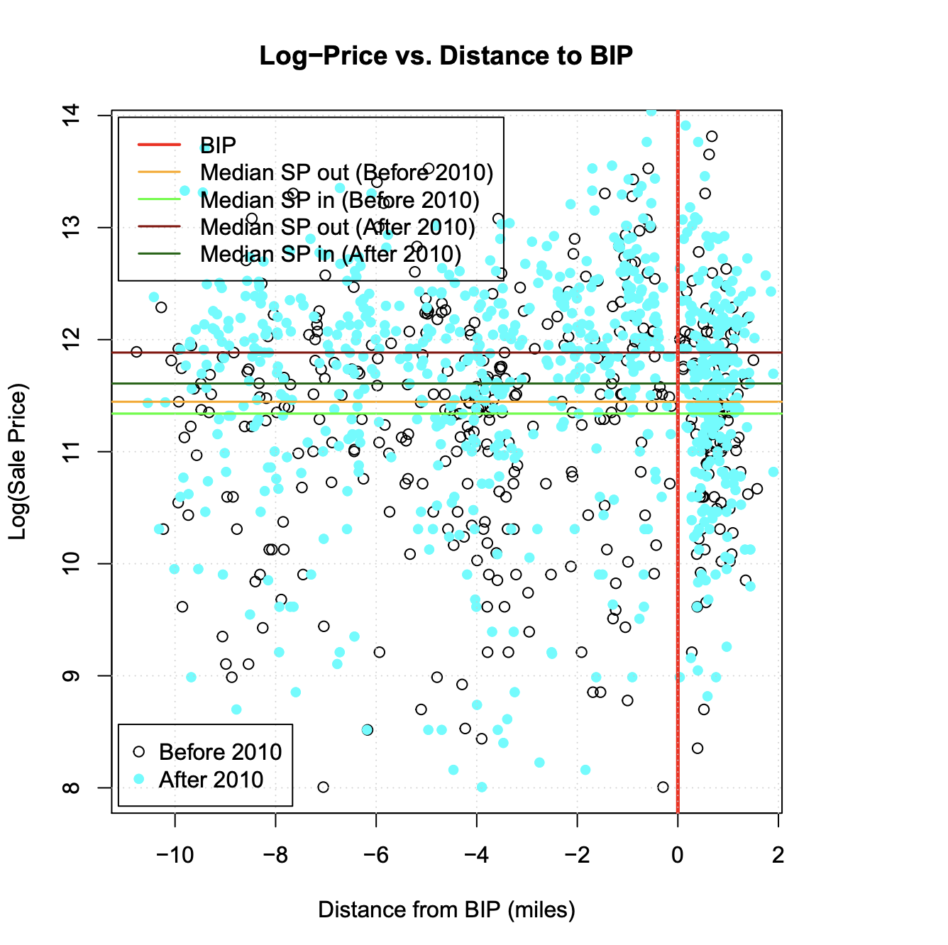
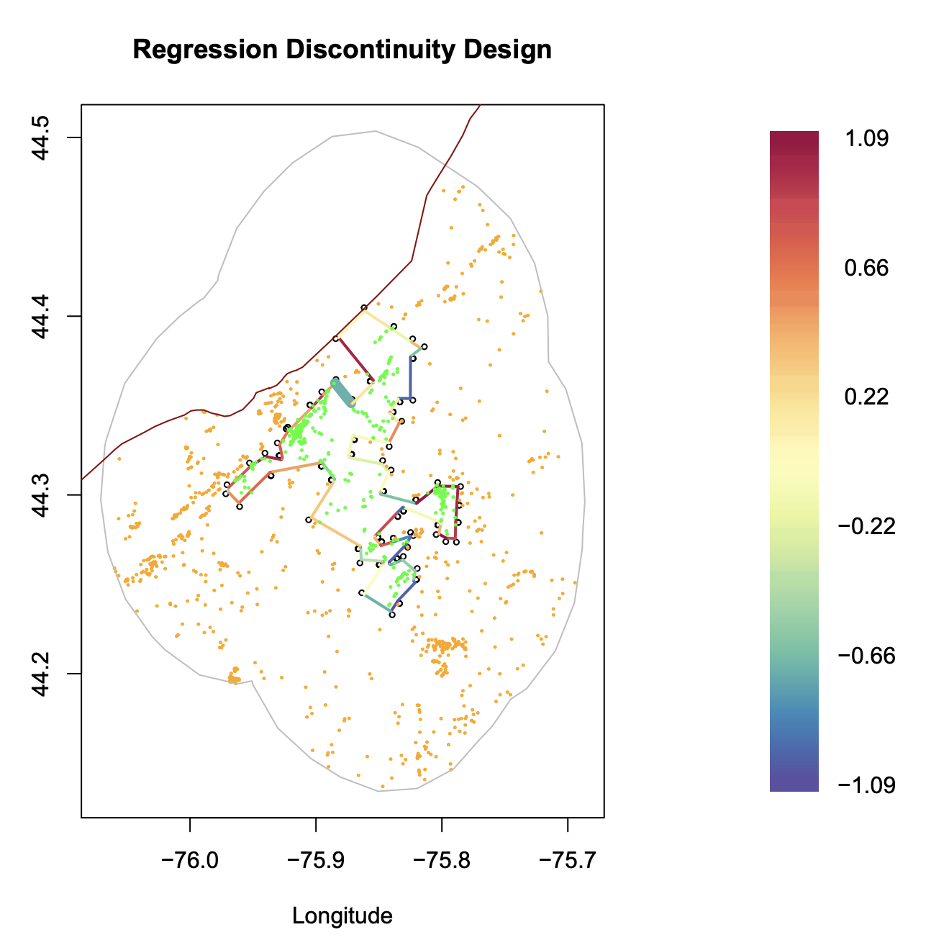
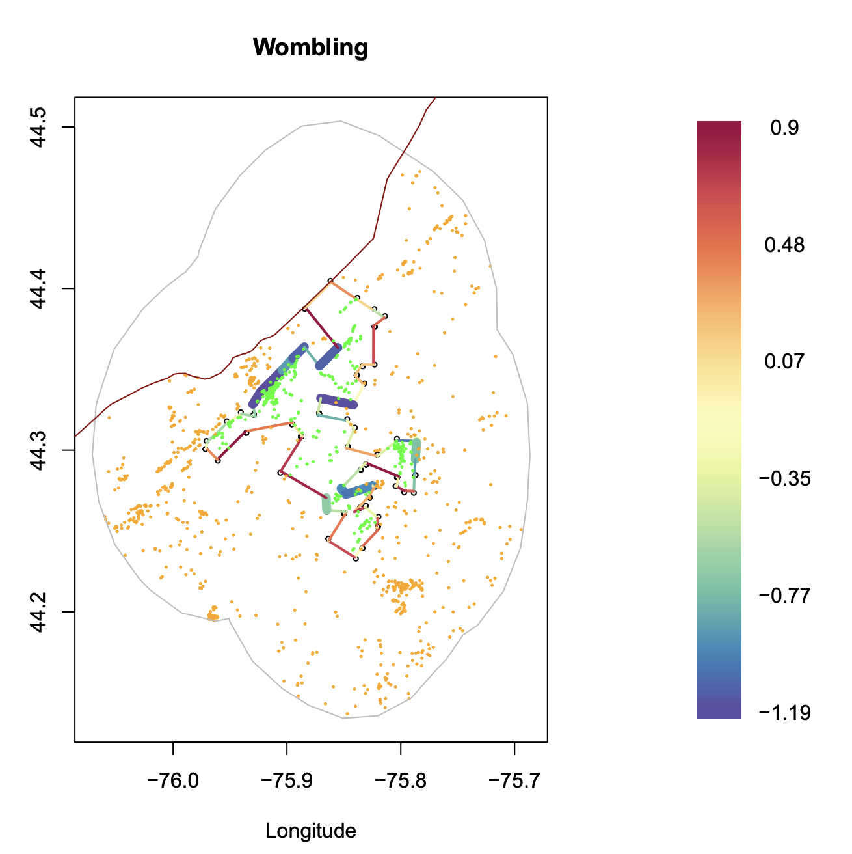
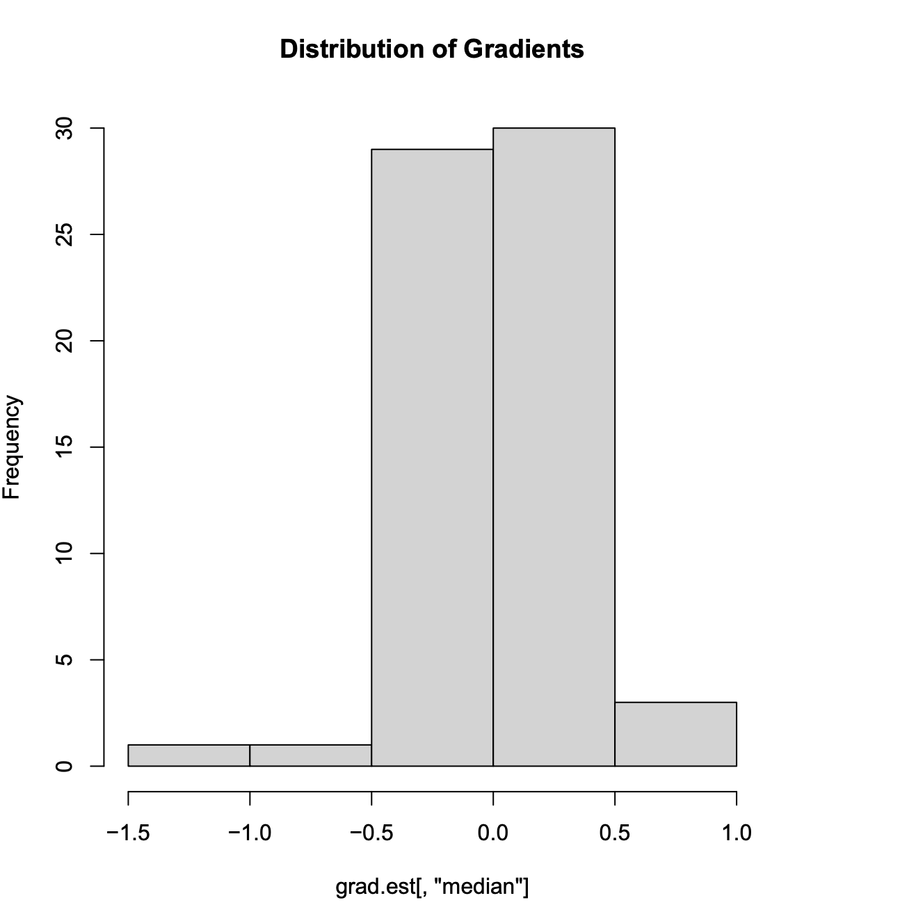
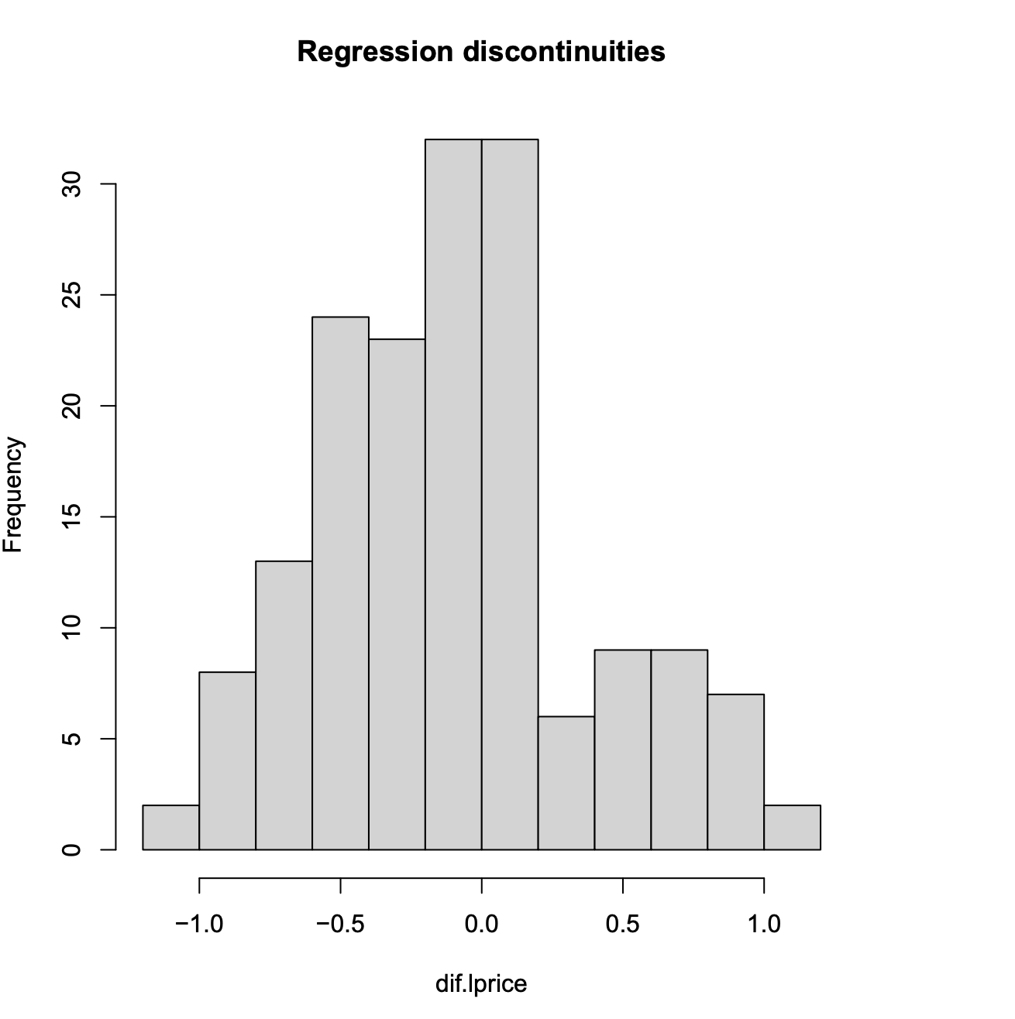
Case Studies: New York
Canada
Canada
Difference (pre) = 0.0170
Difference (post) = -0.1437
20% significant gradients, .6% discontinuities, avg. wombling measure = -0.0925, avg discontinuities=-0.1437. Prices increased by an average of 9% (according to gradients)and 14% (according to the discontinuities) inside the BIP.

Slide 17
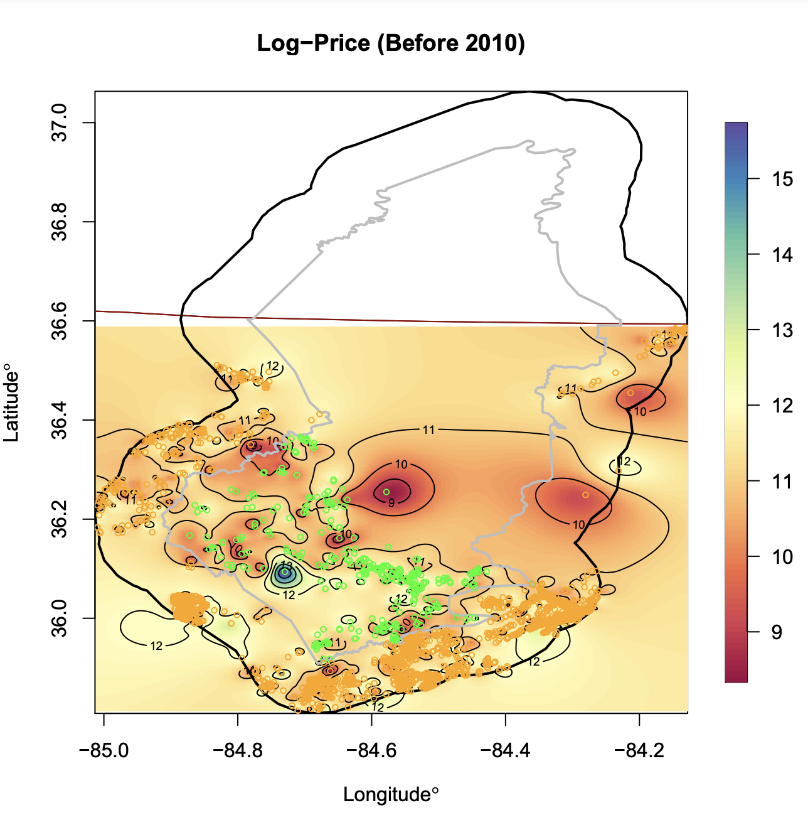
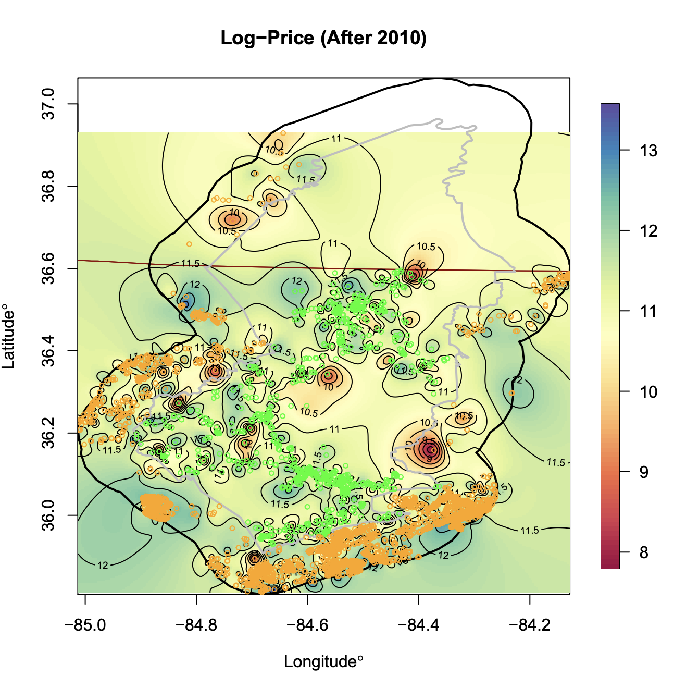
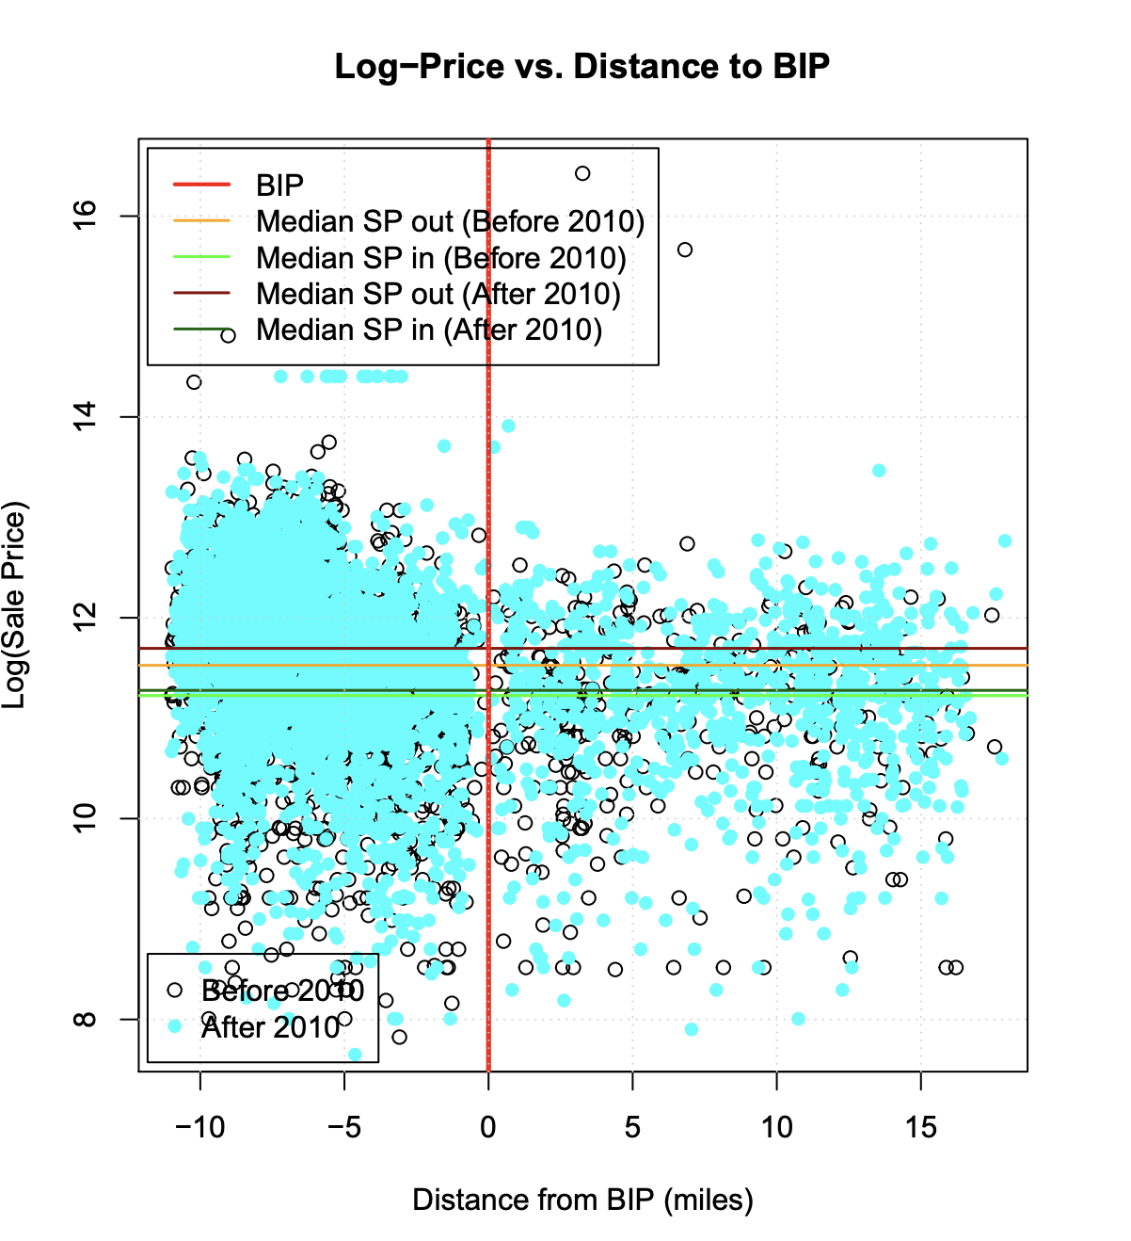
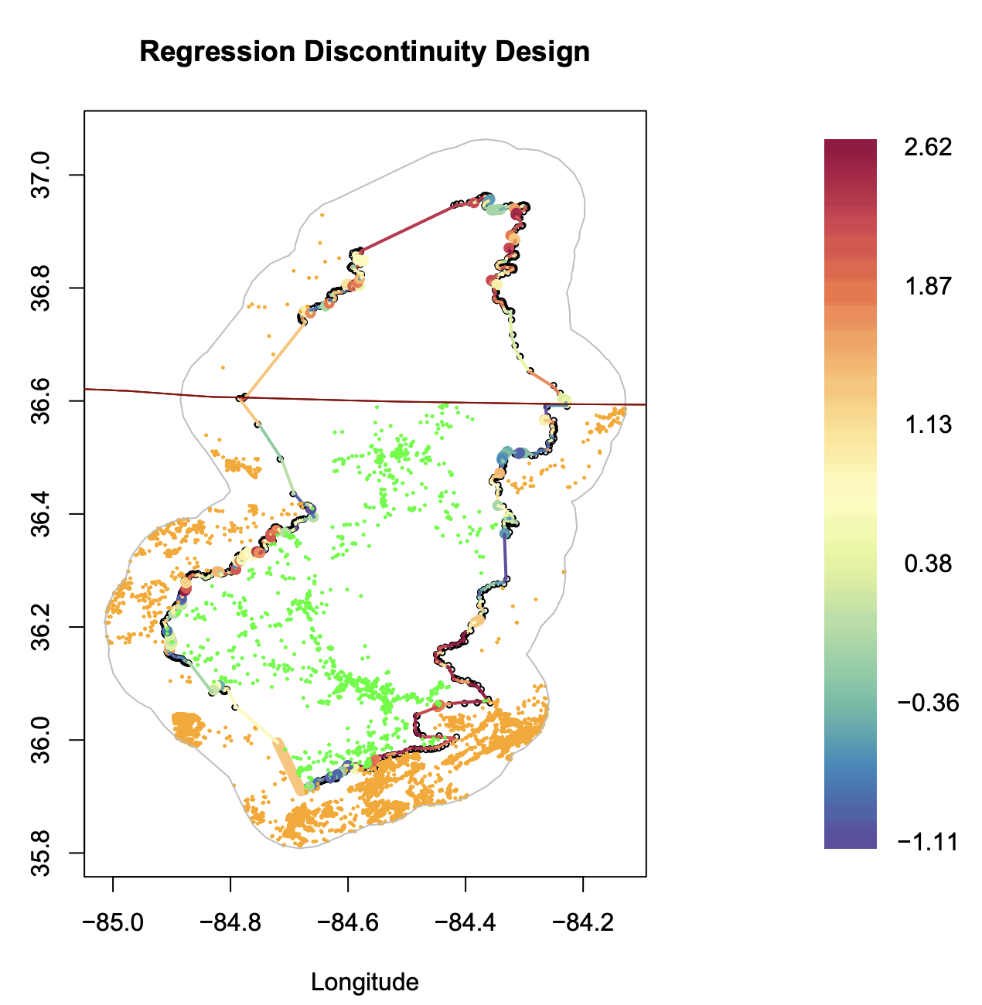
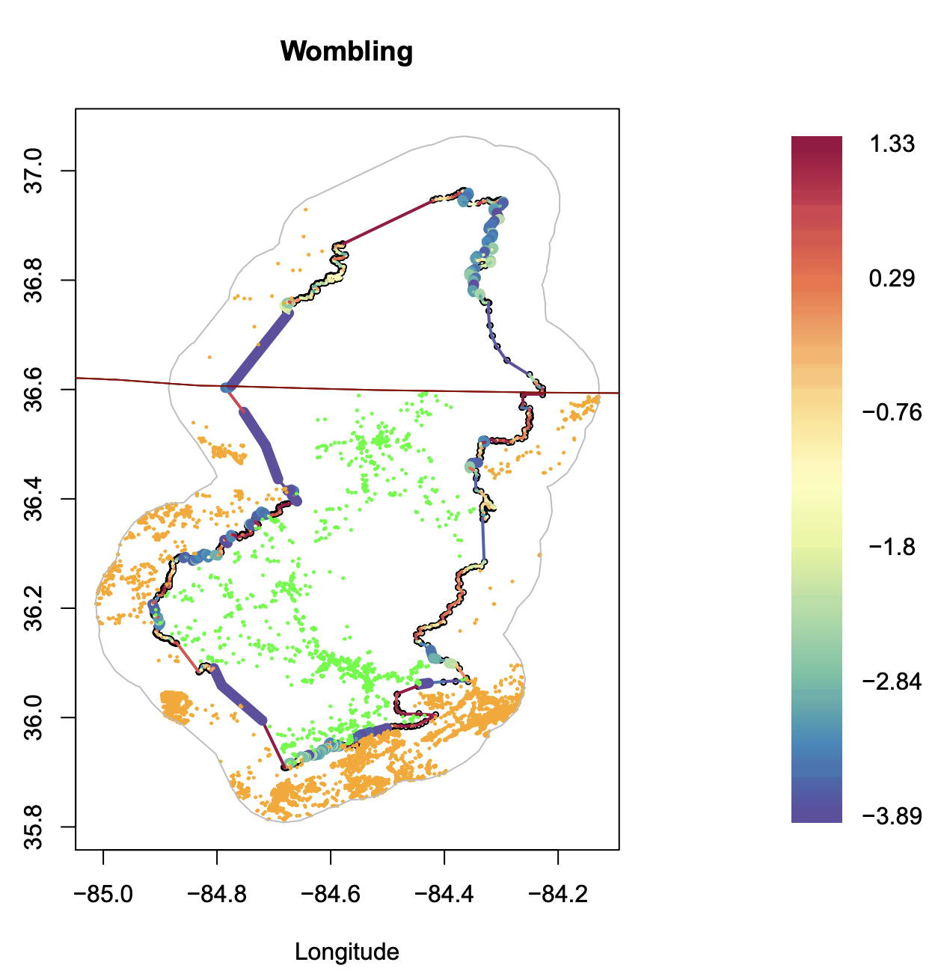
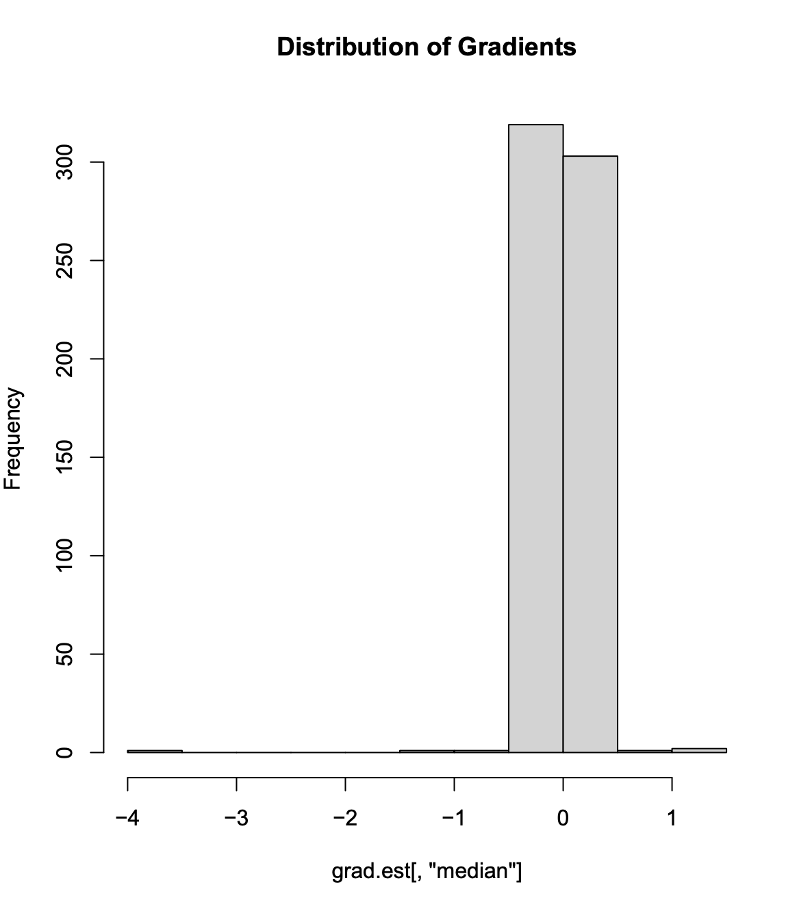
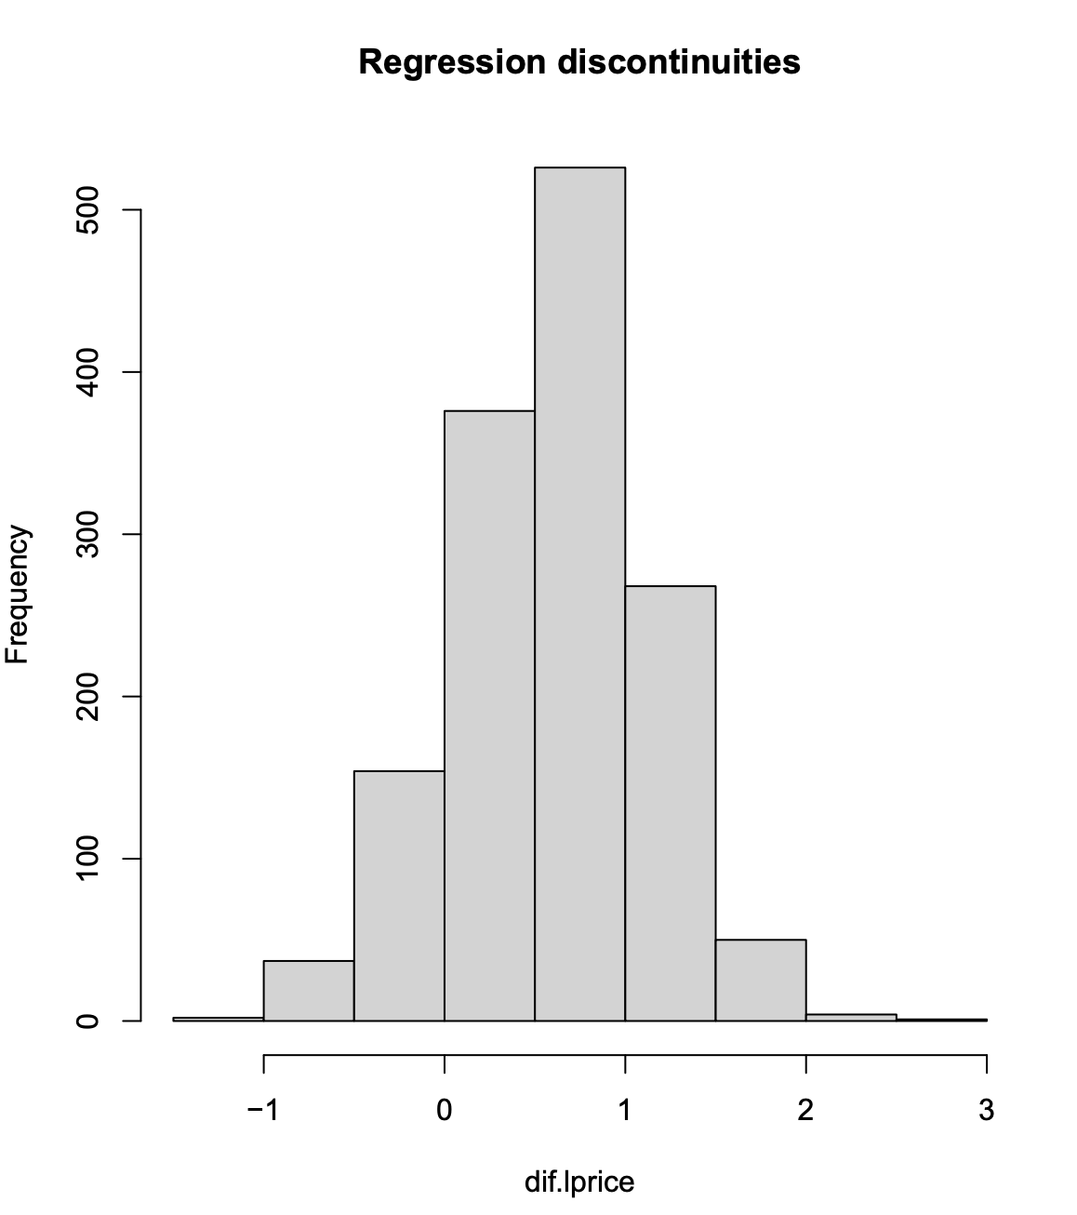
Case Studies: Tennessee
Difference (pre) = -0.4104
Difference (post) = -0.4233
20% significant gradients, 6% discontinuities, avg. wombling measure = -1.2601, avg discontinuities=0.5984. Price difference of 80%.

Slide 18
Conclusions
The proposed methods produce a framework for evaluation of effects for program areas served by the BIP.
The analysis shown uses the BIP program as an example, it is applicable for the evaluation of any subsidy program with a spatially indexed response source (in our case the house prices).
Real estate prices are affected by temporal correlation, extensions of the proposed setup to include time using dynamic spatiotemporal models is a feasible solution.
Inclusion of time would facilitate an evolutionary study of the program impacts.

